Slide 1
Real-Time Streaming with Python ML Inference
Marko Topolnik

Slide 2
About Us
Hazelcast started as an In-Memory Data Grid project (distributed caching with data-local computation)
Java codebase, polyglot clients
we focus on Simplicity
in 2017 we added Hazelcast Jet: In-Memory Distributed Stream Processing
My role: tech lead of the Hazelcast Jet core team

Slide 3
Example: Salary Prediction Python, SciKit Learn, Random Forest

Slide 4
Sample Input and Output
Input: {
"age": 25,
"workclass": "Self-emp",
"fnlwgt": 176756,
"education": "HS-grad",
"education-num": 9,
"marital-status": "Never-married",
"occupation": "Farming-fishing",
"relationship": "Own-child",
"capital-gain": 0,
"capital-loss": 0,
"hours-per-week": 35,
"native-country": "United-States"
}
Output: {
"probability": 0.85
"income": "<=50K"
}

Slide 5
(Showing Project Directory)
Notes:
Ask "Are you using Python in your data science?" What languages are you using?

Slide 6
We have a Web Service Doing ML!
R E S T
Client

Slide 7
Data Science: The Hype
Do Data Science
Profit!

Slide 8
Data Science: The Reality
Package
Deploy
Do Data Science
Profit (fingers crossed)
Scale Up
Re-Train
Scale Out
Monitor
Load-Balance

Slide 9
Productionizing the REST service
Request #1
R E S T
Request #2
Request #3
Parallelism?

Slide 10
Productionizing the REST service
Request #1
REST
Request #2
REST
Request #3
REST
Load-Balancing?

Slide 11
Productionizing the REST service
REST
Request #1
Load Balancer
REST
Request #2
REST
Request #3
Batching?

Slide 12
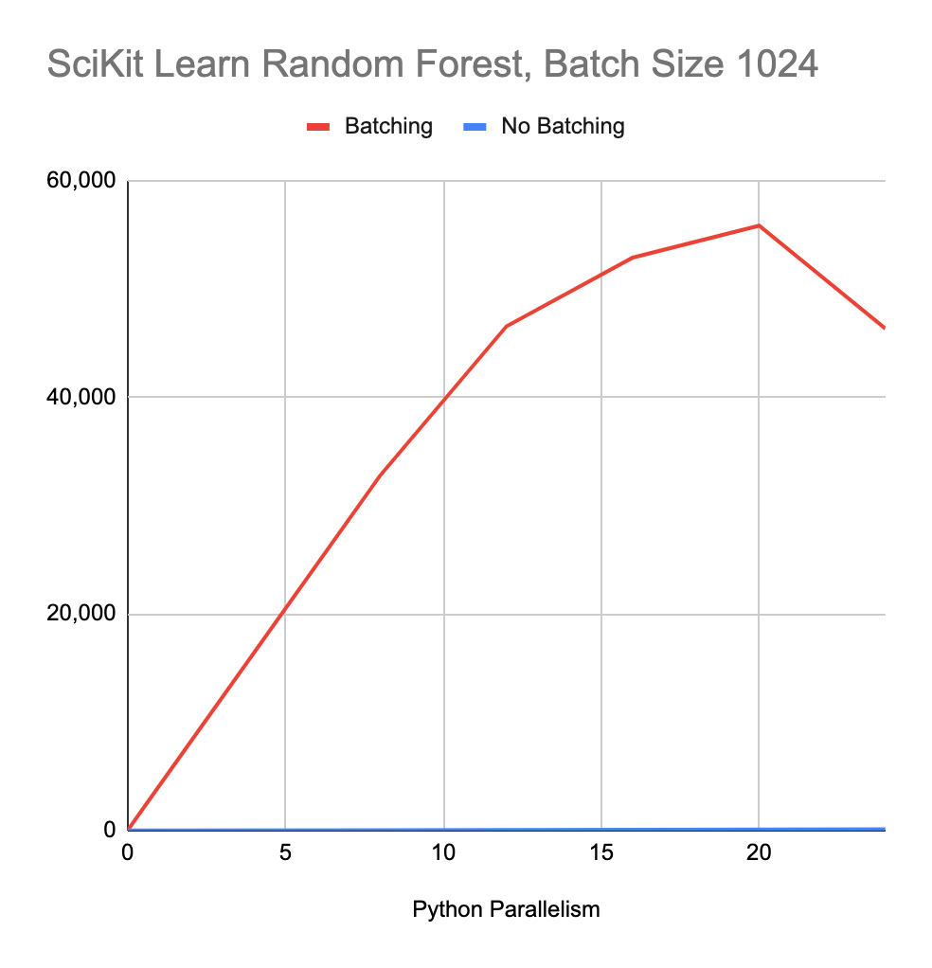
Effect of Batching on Throughput

Slide 13
Productionizing the REST service
REST
Request #1
Batch
Request Queue
Batch
Load Balancer
REST
Request #2
Response Queue
REST
Request #3

Slide 14
Replace REST with Distributed Streaming
Request #1
Kafka
Hazelcast Jet Cluster
Request #2
Request #3
$ jet submit ML

Slide 15
Hazelcast Jet Code
Pipeline p = Pipeline.create();
p.readFrom(Kafka.source())
.apply(mapUsingPython(new PythonServiceConfig()
.setBaseDir("/Users/mtopol/dev/python/sklearn")
.setHandlerModule("example_1_inference_jet")))
.writeTo(Kafka.sink());
jet.newJob(p);
$ mvn package
$ jet submit target/my-job.jar

Slide 16
Jet Job's Execution Plan
Kafka Topic A
Jet Node 1
Source
Batch
Batch
Python process
mapUsing Python
mapUsing Python
Python process
Sink
Kafka Topic B

Slide 17
Let's Start a Jet Cluster!

Slide 18
Jet's Stream Operators
windowed aggregation using Event Time
sliding, session window
count, sum, average, linear regression, ...
custom aggregate function
rolling aggregation
streaming join (co-grouping)
hash join (enrichment)
contact arbitrary external services
mapUsingPython uses this

Slide 19
Jet's Cooperative Multithreading (1/2)
Source
FlatMap + Filter
Group + Accumulate
Combine
Sink
local round-robin
local partitioned
distributed partitioned
local round-robin

Slide 20
Jet's Cooperative Multithreading (2/2)
Cooperative Thread 1
Cooperative Thread 2
Non-Cooperative Thread 1
FlatMap + Filter
FlatMap + Filter
Source
Group
+
Acc
Group
+
Acc
Non-Cooperative Thread 2
Combine
Combine
Sink
From Accumulate
To Combine

Slide 21
Cluster Elasticity and Resilience
Jet jobs are fault-tolerant
nodes can join and leave the cluster, jobs go on
automatically rescale to available hardware

Slide 22
Cluster Self-Formation
Hazelcast Jet natively supports:
Amazon AWS
Google GCP
Kubernetes
With simple configuration, the nodes self-discover in these environments

Slide 23
Source and Sink Connectors
Kafka
Change Data Capture: MySQL, PostgreSQL, ...
HTTP: WebSocket, Server-Sent Events
Hadoop HDFS
S3 bucket
JDBC
JMS queue and topic

Slide 24
Thanks for attending!
Q&A
marko@hazelcast.com
@mtopolnik

