Slide 1
Graph Processing for Open Metadata and Governance
Mandy Chessell, IBM
Egeria Open-Source Project Lead

Slide 2

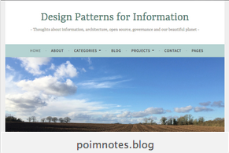
Brief Introduction
Mandy Chessell CBE FREng CEng FBCS
  IBM Distinguished Engineer
  Project Leader of the EGERIA open-source project
  Based in the UK
  30+ Years experience

Slide 3
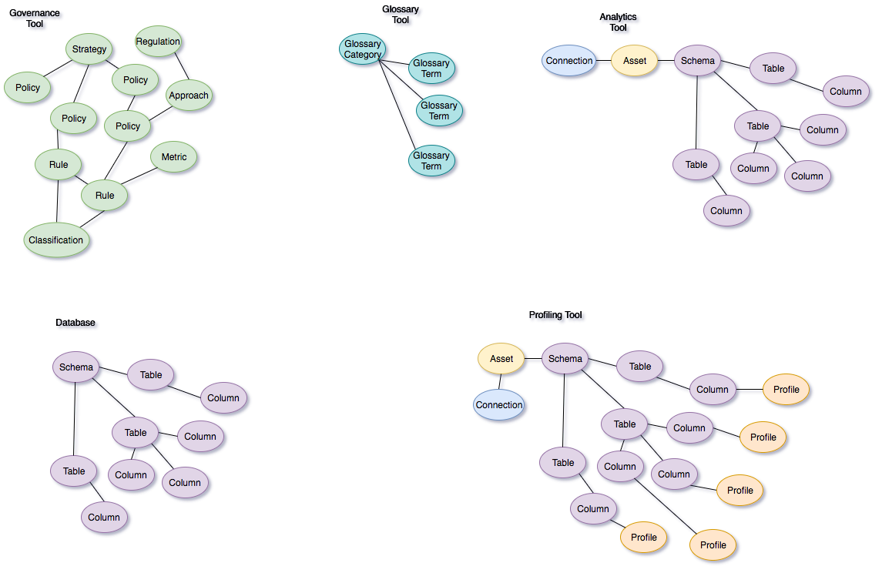
Observations on data-driven projects

Slide 4
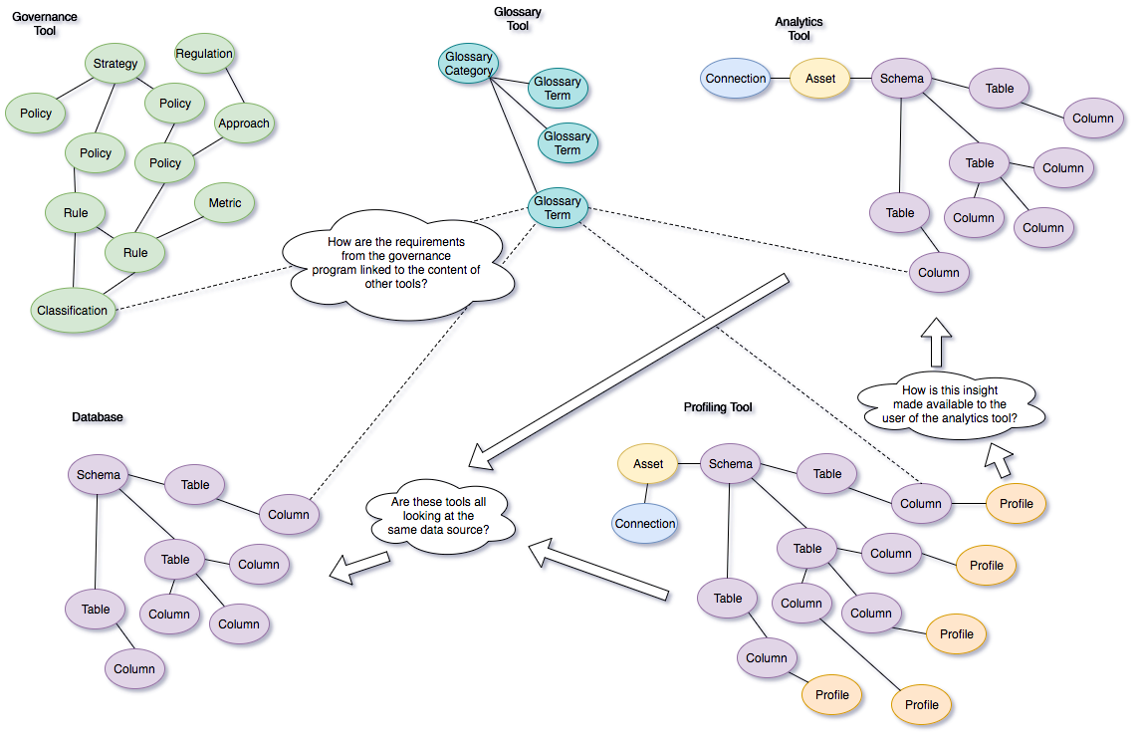
Observations on data-driven projects

Slide 5
But what if we linked everything together …

Slide 6

Egeria Value
Egeria enables the sharing of knowledge between people and process that use different tools and technologies
  Increasing agility, collaboration and the availability of relevant data when making decisions.
  Breaking down silos between traditional technologies such as data and applications; applications and infrastructure management; security and data.

Slide 7

This is not a new problem …
Over the years, our industry has gained plenty of experience discovering what does not work
  Centralized metadata repository
  “Just use our tools” – Single vendor lock in
  Paper standards that each vendor implements
  Bridges that copy metadata between tools
  Bespoke point-to-point integrations between tools

Slide 8

What is different about Egeria
Open source, multi-vendor and client collaboration
Peer-to-peer architecture; retaining the value of each technology
Self-configuring, distributed, real-time exchange of knowledge
Scales from Raspberry Pi to multi-instance HA cloud deployment
Multi-tenant
Instance based security
Customizable through connectors

Slide 9
How does ODPi Egeria work?
ODPi Egeria enables exchange of metadata between tools from different vendors
Development
DevOps
Data Science
Open and
Unified Metadata

Slide 10
Achievements
Virtual graph of metadata maintained across distributed heterogenous metadata repositories.
Frameworks, APIs and connectors for minimizing integration cost for different types of technologies
Virtual repository explorer UI
Instance based security
Controlling visibility of assets through zones
Scalable, secure platform configurable and customizable through connectors
Purpose-based data access
Metadata versioning and provenance
Multi-tenant UI based on carbon
500 linked open metadata types demonstrating how the knowledge from many tools can be linked together.
Open metadata repository interface proven for table, graph and hierarchical DB stores.
Enterprise queries and replication across heterogeneous technologies
Conformance test suite and mark
Automated configuration of data virtualization technology and security as new data sets are added to a data lake
Suite of persona-based labs and tutorial using Jupyter Notebooks.
W3C semantic standards pattern for data model exchange
Automation of metadata acquisition through templates, daemons, discovery services and stewardship.
Classification of assets
Reference data management
Multi-technology collaboration and feedback
Multi-domain governance model
Digital service lifecycle, from business design, development, devOps and use.
Comprehensive open lineage services.

Slide 11
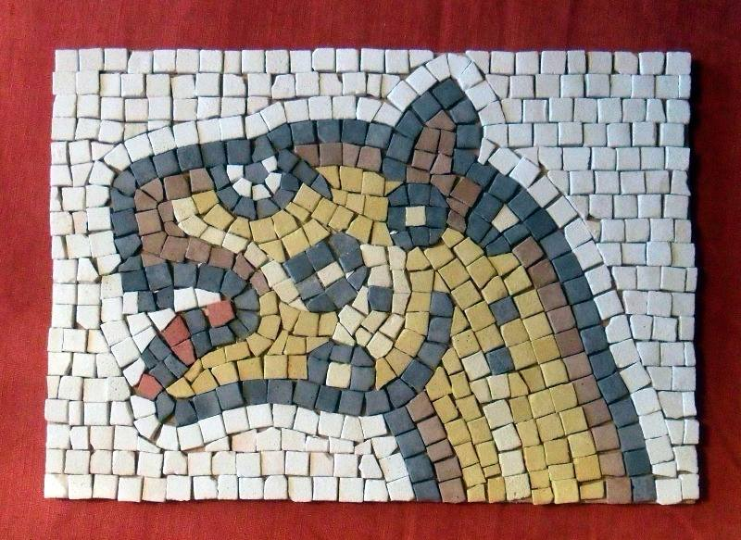
Building the big picture
Notes:
https://www.myattgarden.lewisham.sch.uk/wp-content/uploads/2014/04/roman-mosaic.jpg

Slide 12
Linked up value

Slide 13
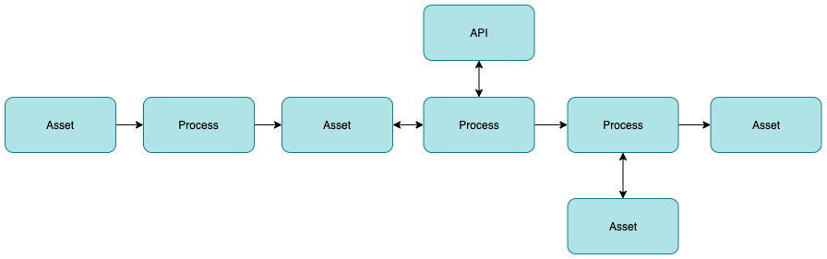
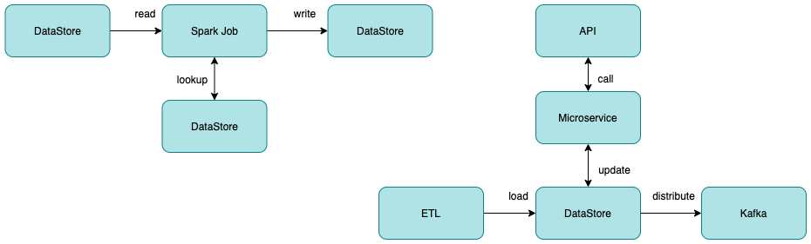
Basic lineage structure

Slide 14
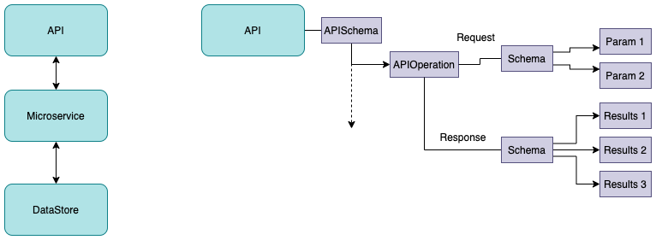
Modelling different type of technologies for lineage

Slide 15
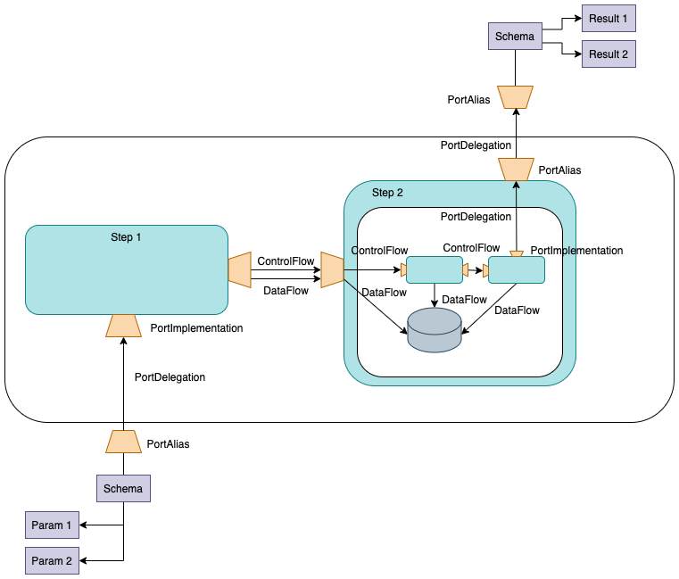
Modelling different type of technologies for lineage

Slide 16
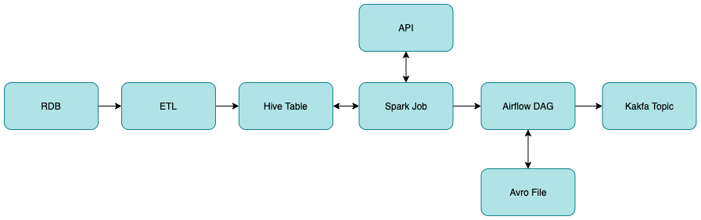
Lineage capture
Lineage capture involves contributions from many technologies
Each technology contributes what they know to open metadata
and the metadata service stitches it together.
The stitching process is a mixture of automated matching and
human stewardship.
Consistency in naming and use of open metadata types increases the
effectiveness of the stitching process.

Slide 17
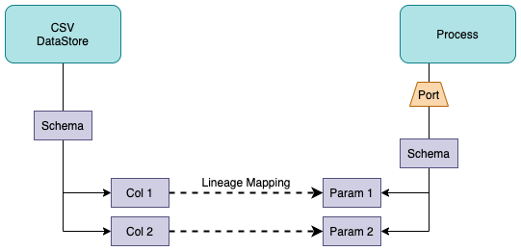
Stitching lineage together
Stitching can happen at different levels of granularity
  Data Field ←→ Data Field
  Port ←→ Port
  Process←→Asset

Slide 18
Information Supply Chain
The end to end flow of a particular type of data.
Operational Systems Zone
Data Lake
Governance Catalog (Metadata) Zone
Optimized to improve timeliness, remove inconsistencies, reduce cost
Discovered through metadata …

Slide 19
Example of a simple cohort
Data Lake
Cohort A
Chief Data Office
Systems of Record

Slide 20
Connecting to multiple cohorts
Data Lake
Marketing
Data Lake
Cohort A
Cohort B
Chief Data Office
Systems of Record
Systems of Record
Mobile
Apps

Slide 21
Formation of a cohort
The first server to join the cohort issues a registration request and waits for others to join.

Slide 22
Formation of a cohort
When another server joins the cohort they exchange registration information.

Slide 23
Formation of a cohort
Once the registration is complete the cohort members can issue federated queries.

Slide 24
Formation of a cohort
Metadata can also be replicated through the cohort to allow caching for availability and performance

Slide 25

Instance representations in the metadata in the cohort
Notes:
Here is an example of a number of OMRS instance objects – there are two entities, that are connected by a relationship.
Also, one of the entities has two classifications.
All of the instances have attributes – some will be core attributes used for type or control information; others will be attributes that are specific to the instance type (known as type-defined attributes).
You don’t need to remember this picture – we’ll stick a copy of it in the top corner so we can refer back to it…..

Slide 26
Scope of metadata covered
Governance
Glossary
Collaboration
Models and
Reference Data
Lineage
Metadata
Discovery
Data Assets
Base Types, Systems
and Infrastructure

Slide 27
Open Metadata Types
https://egeria.odpi.org/open-metadata-publication/website/open-metadata-types/
Strategy
4
Subject Area Definition
1
Teaming Metadata
(people profiles, communities, projects,
notebooks, …)
Policy Metadata (Principles, Regulations, Standards, Approaches, Rule Specifications, Roles and Metrics)
Business Objects and Relationships, Taxonomies and Ontologies
Augmentation
3
Organization
Feedback Metadata
(tags, comments, ratings, …)
Rollout
Classification
Business Attributes
Campaigns and Projects
Classification Schemes
Implementation
Mapping
Governance Actions and Processes
Rights
Management
Models and Schemas
2
Asset Collections
(Sets, Typed Sets, Type Organized Sets)
Reference Data
5
Instrument
7
Information Process
Instrumentation (design lineage)
Association
Information Views
Augmentation
Discovery
Metadata (profile data, technical classification, data classification,
data quality assessment, …)
Physical Asset Descriptions
(Data stores, APIs,
models and components)
0
Basic Types, Infrastructure and Systems
Access
6
Connectors

Slide 28
Linking metadata across the cohort
Database
Column
Glossary Term
OMAG Server 1
OMAG Server 2
Entity
Entity

Slide 29
Linking metadata across the cohort
Database
Column
Glossary Term
Glossary
Term
Meaning
OMAG Server 1
OMAG Server 2
Reference
Copy
Relationship

Slide 30
Linking metadata across the cohort
Database
Column
Glossary
Term
OMAG Server 1
OMAG Server 2
Database Column
Glossary
Term
Meaning
OMAG Server 3

Slide 31
Linking metadata across the cohort
Database
Column
Glossary
Term
OMAG Server 1
OMAG Server 2
Database Column
Glossary
Term
Sensitive
Meaning
OMAG Server 3

Slide 32
Understanding data …
Business
metadata
IS-A
Employee
Sensitive
HAS-A
Work Location
HAS-A
HAS-A
Hourly Pay Rate
Manager
Compensation Plan
HAS-A
IS-A
HAS-A
Job Title
IS-A
HAS-A
Employee Id
Annual Salary
Employee Name
Structural
metadata for
a data store
EmpName
EmpNo
JobCode
Salary
Employee Record
Data
00 3809890 6 7 Lemmie Stage 818928 3082 4 New York 4 27 DataStage Expert 1 45324 300 27 Code St Harlem NY 1 3
Notes:
Business metadata describes the data that the business needs, what it means and how it should be classified and protected.
Structural metadata describes how the data is actually stored and labelled in the data store.
The linkage between the business and technical metadata allows our technology to switch between these two perspectives. For example,
A request for data expressed in business terminology can be translated into a query for data from a data store.
An integration engine copying data into a sand box can discover which are the fields that the business classifies as sensitive and then mask these values dynamically.

Slide 33
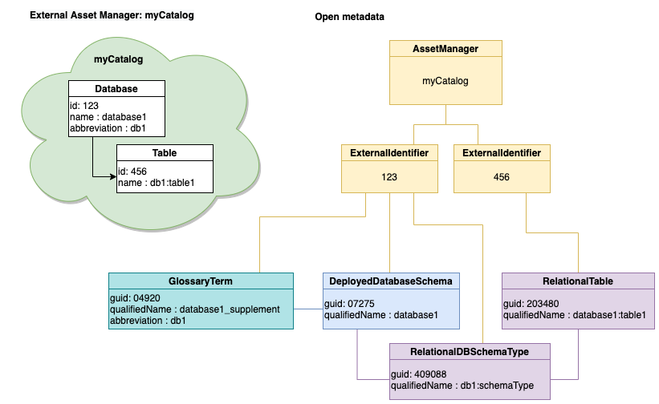
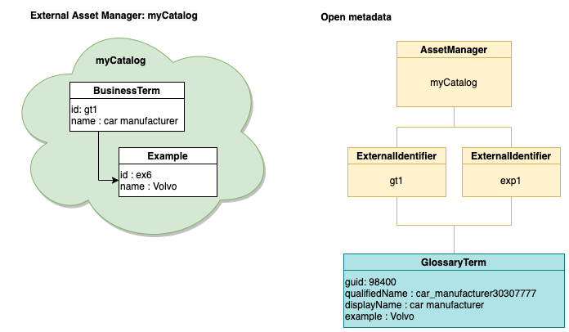
Examples of granularity challenge

Slide 34
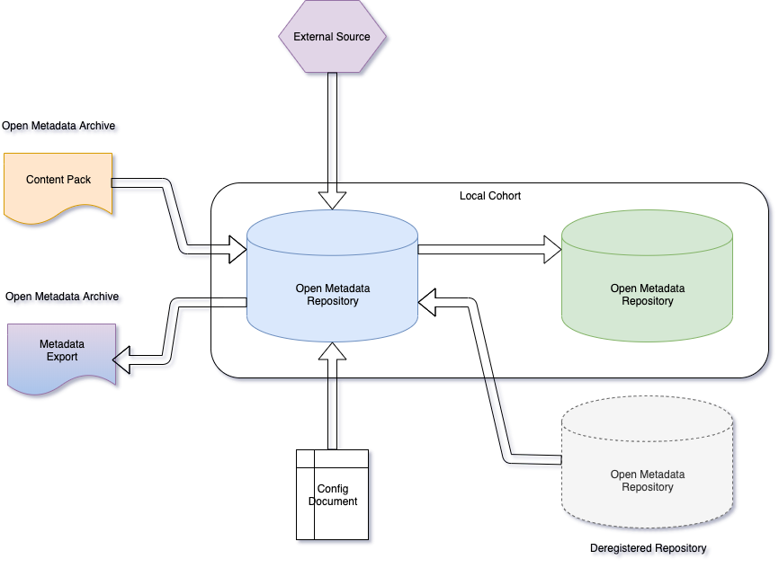
Metadata provenance
If metadata is incorrect, it is important to know where it came from
Every instance of open metadata has full provenance information

Slide 35
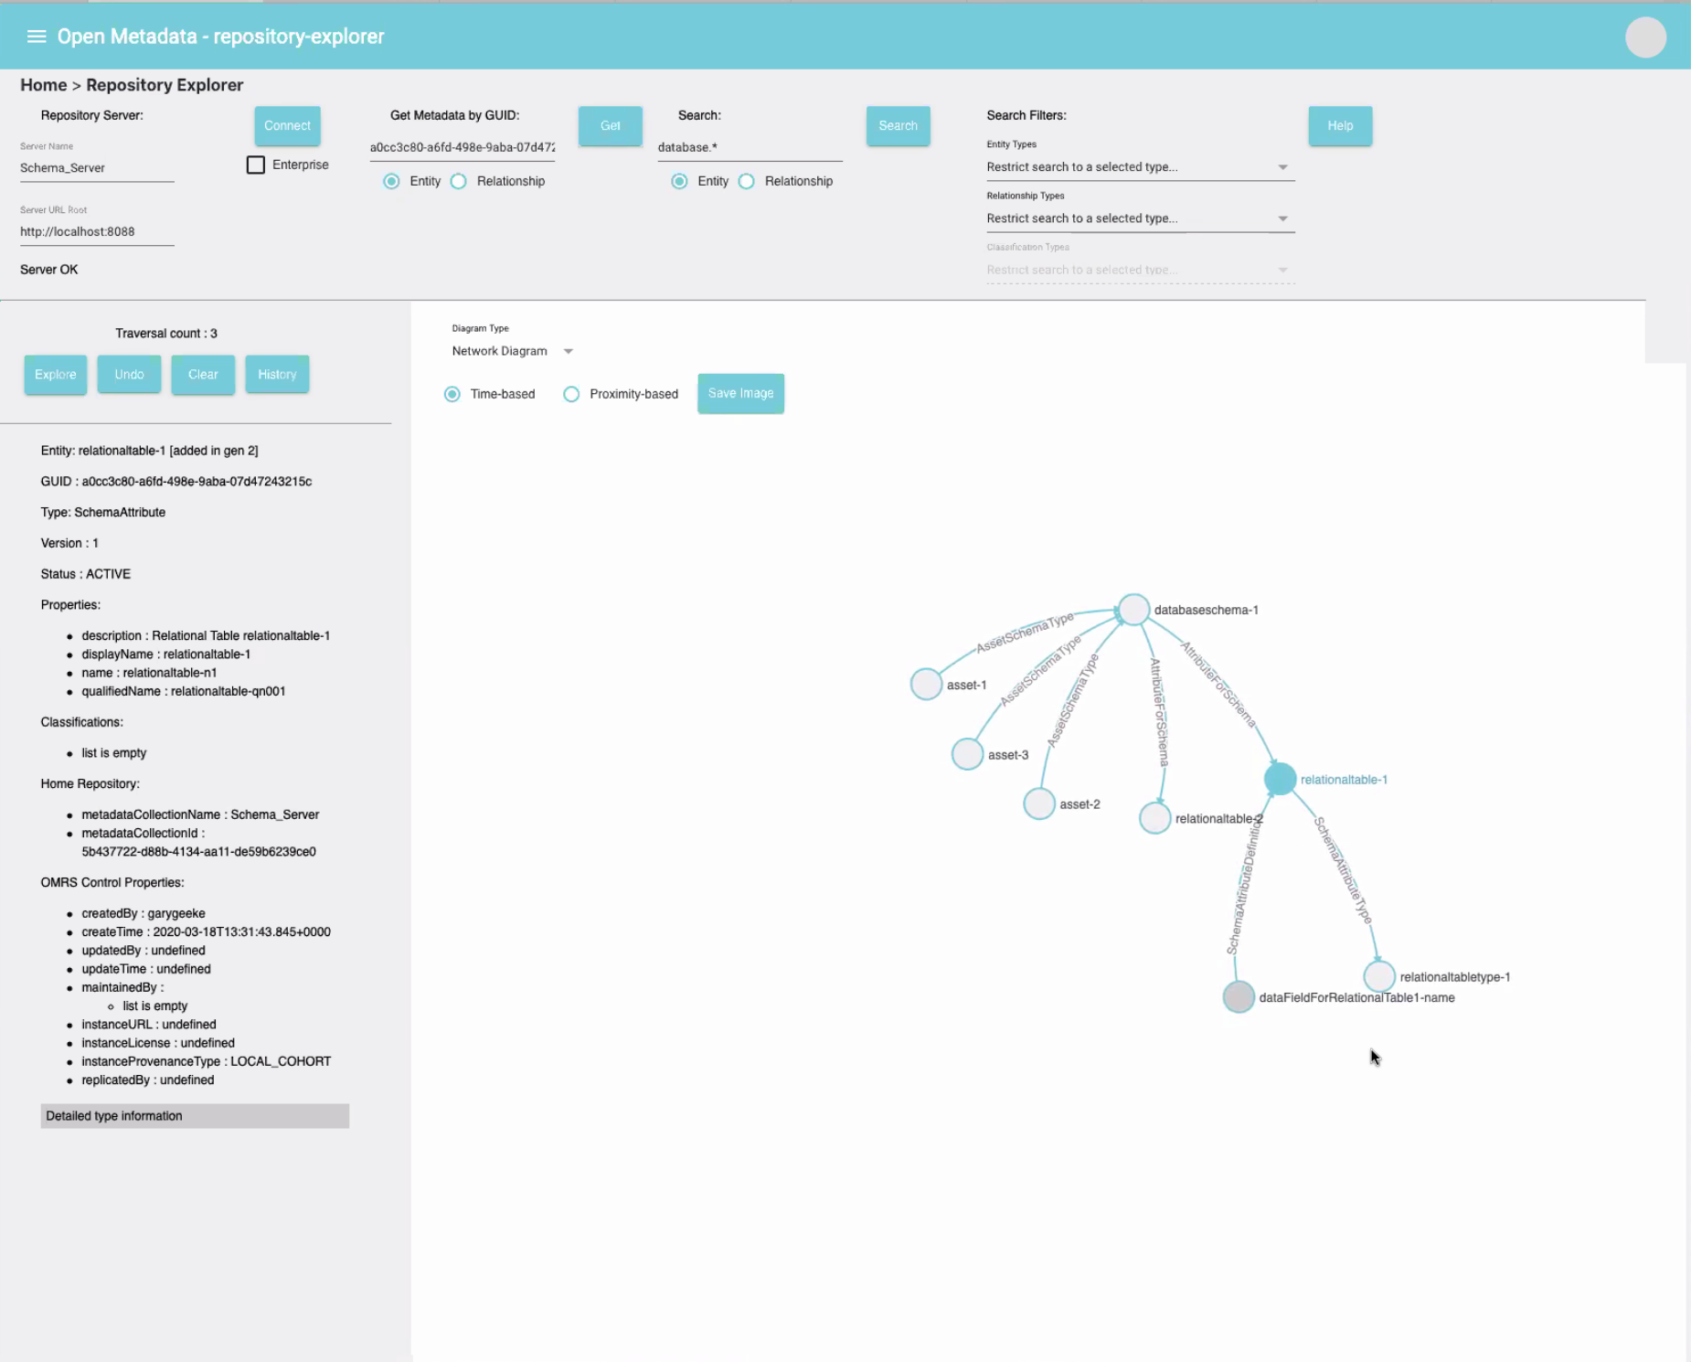
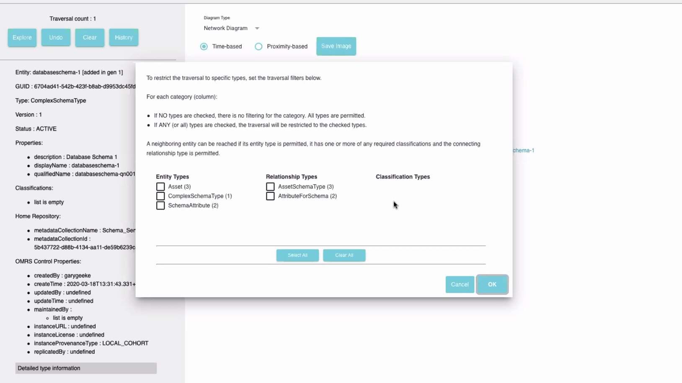
Repository explorer

Slide 36
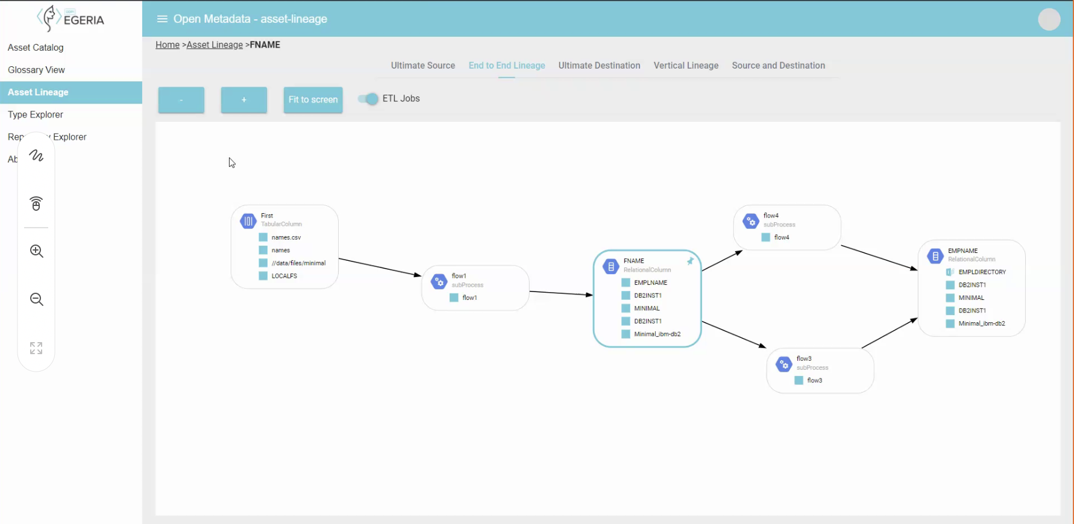
Lineage

Slide 37
Why do vendors work with Egeria?
Linking old platform with new platform
Linking multiple versions of own product deployed across an enterprise
Offload integration implementation costs
Access to third party metadata:
  Open-source technology’s and other vendor’s metadata
Governing third party technologies

Slide 38
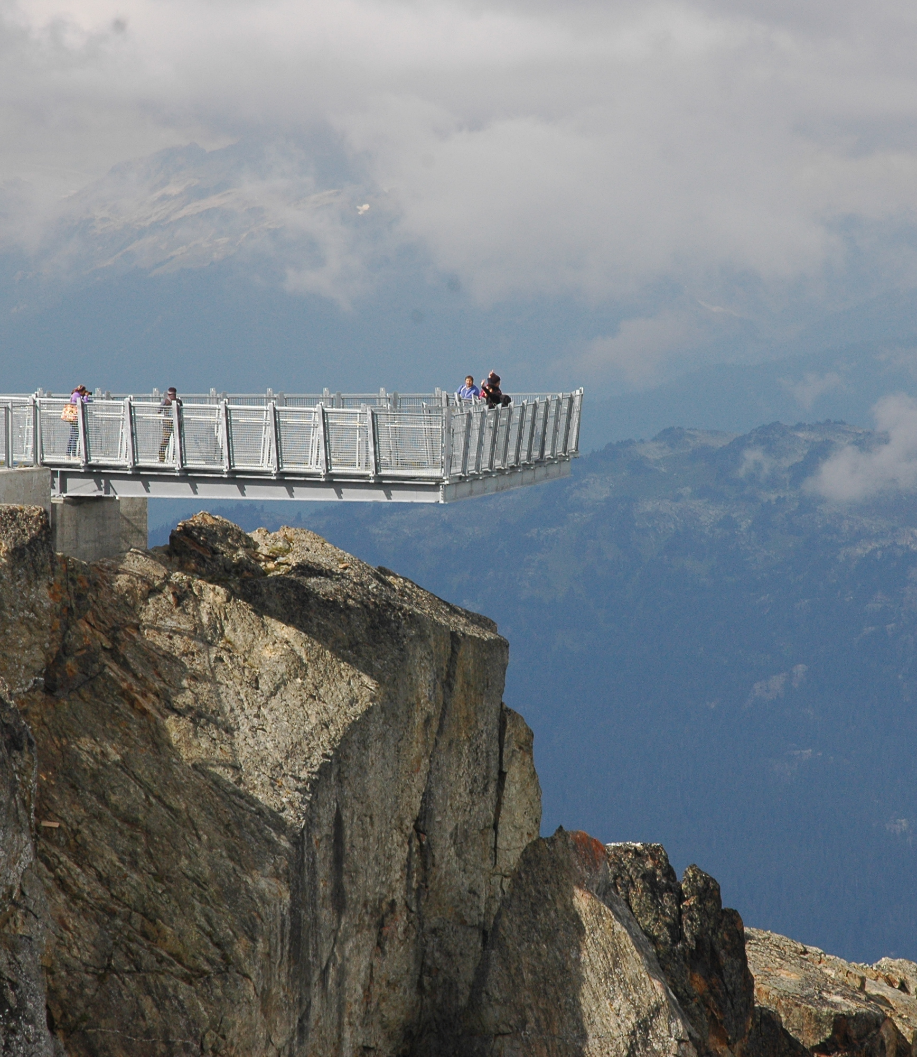
How do we work
Iteratively perform a series of practical experiments that ignore the boundaries of traditional approaches.
  Holistic approach
  Open, public collaboration
  Developing interest and partnership as we go
  Agile development with feedback loop
  Enterprise grade software

Slide 39
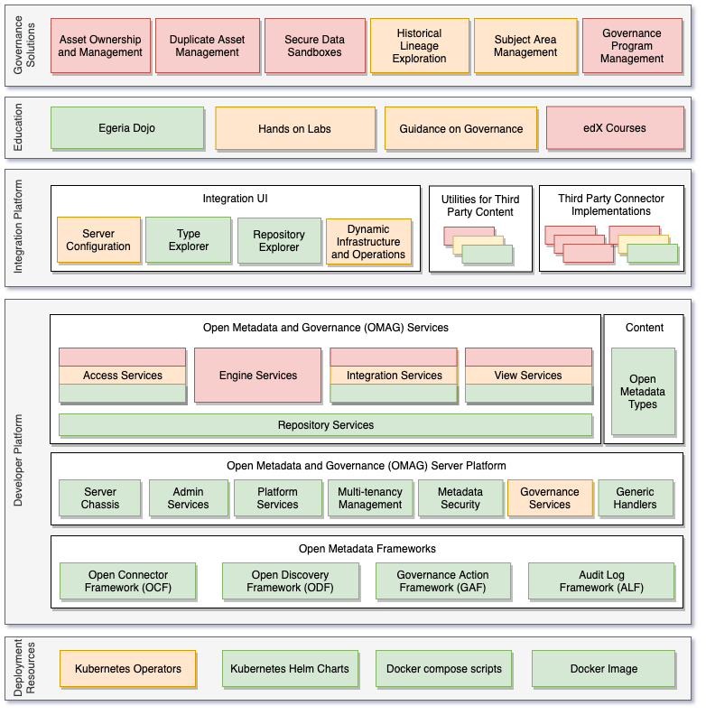
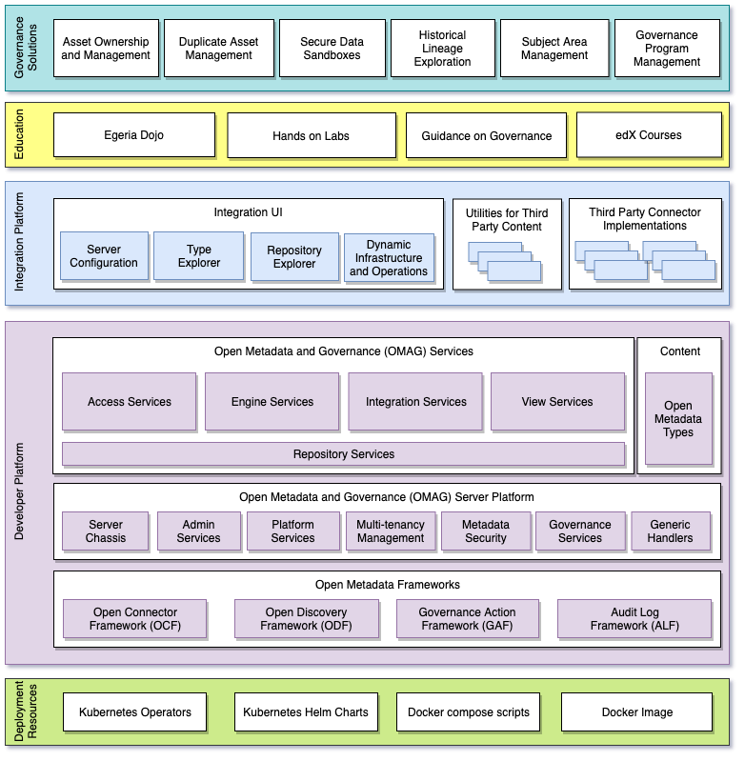
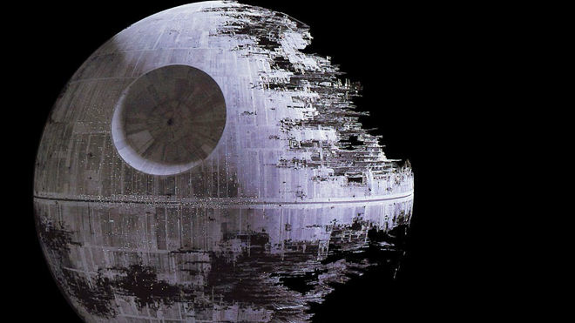
Development Status
Development in plain sight
Monthly releases
  What is ready, goes …

Slide 40
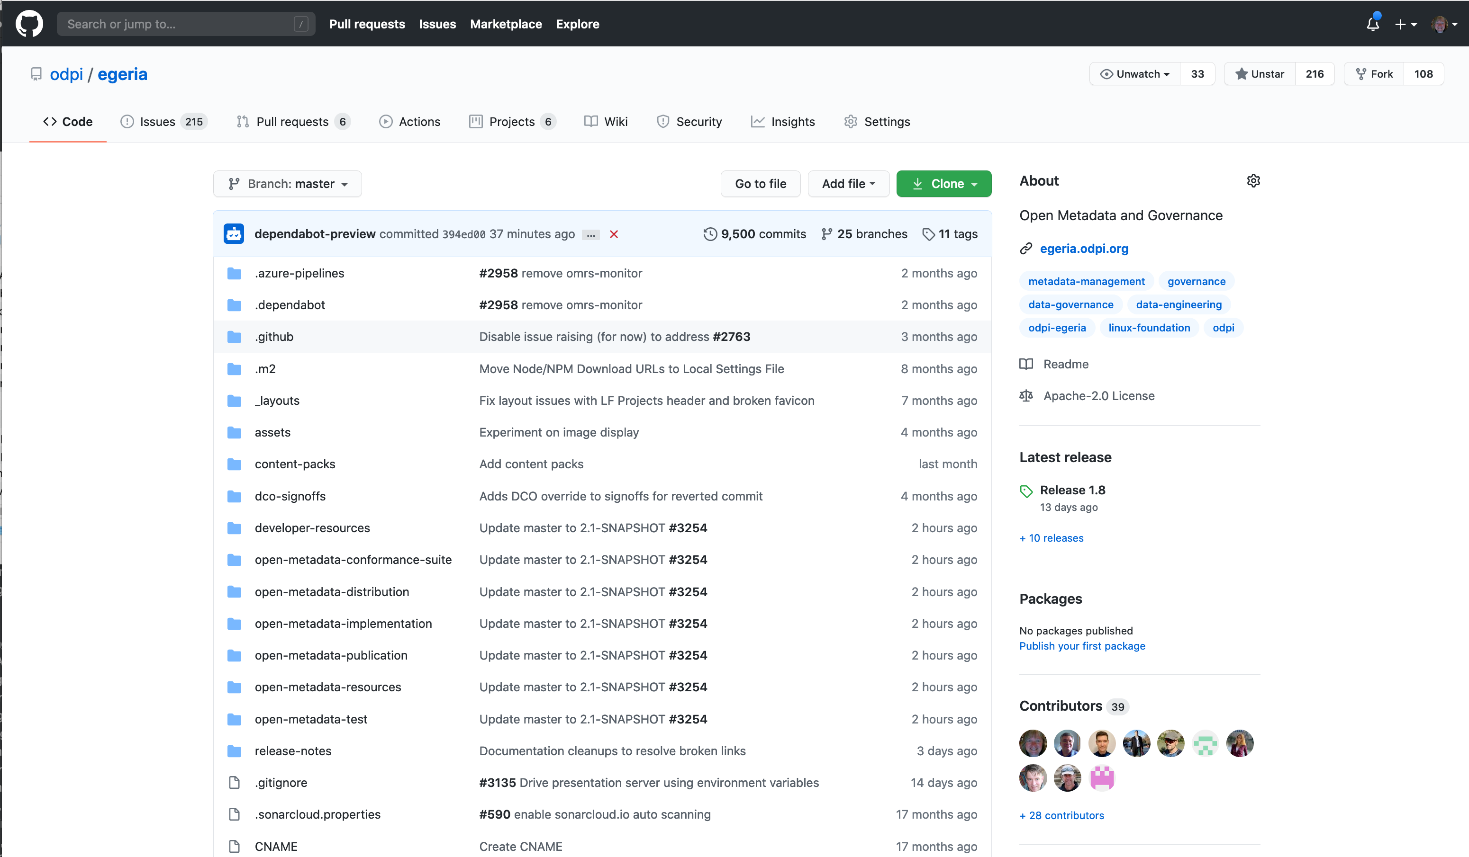
GitHub is the heart of the project
Code repository
Issues
Code Changes
Build
Shop window

Slide 41
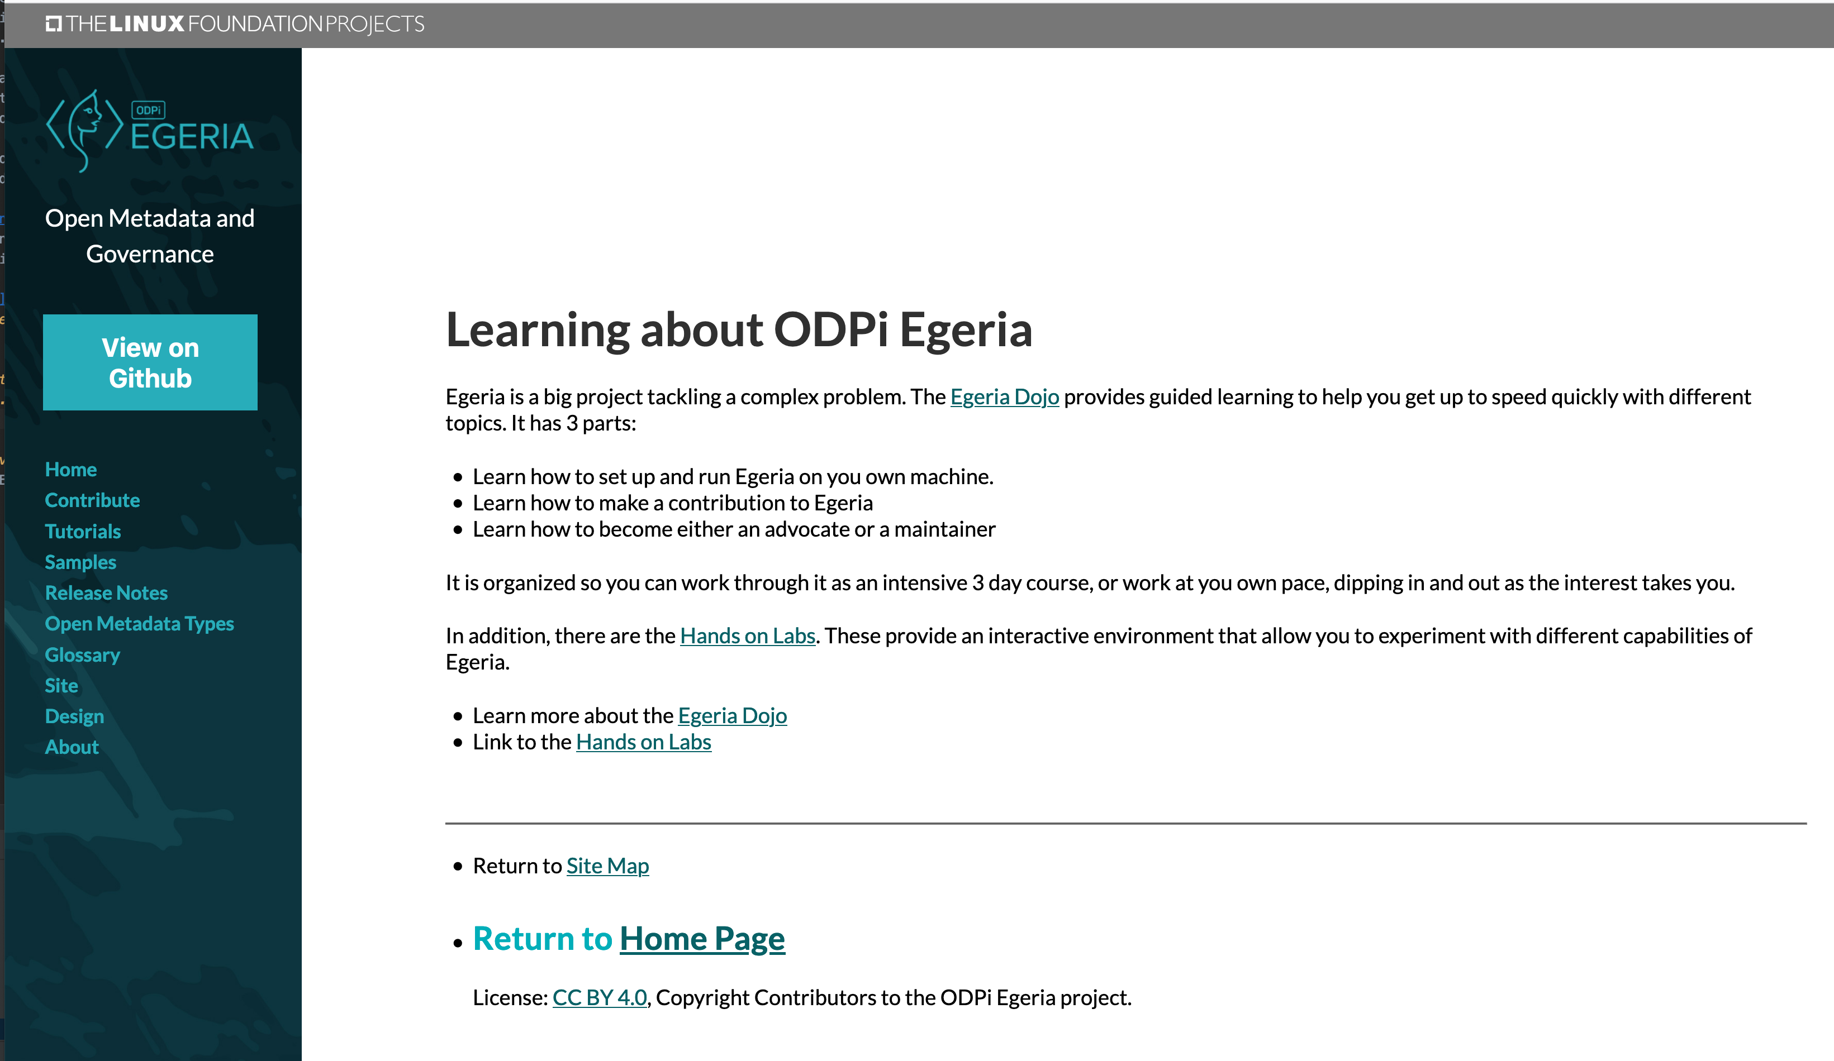
Egeria Tutorials

Slide 42
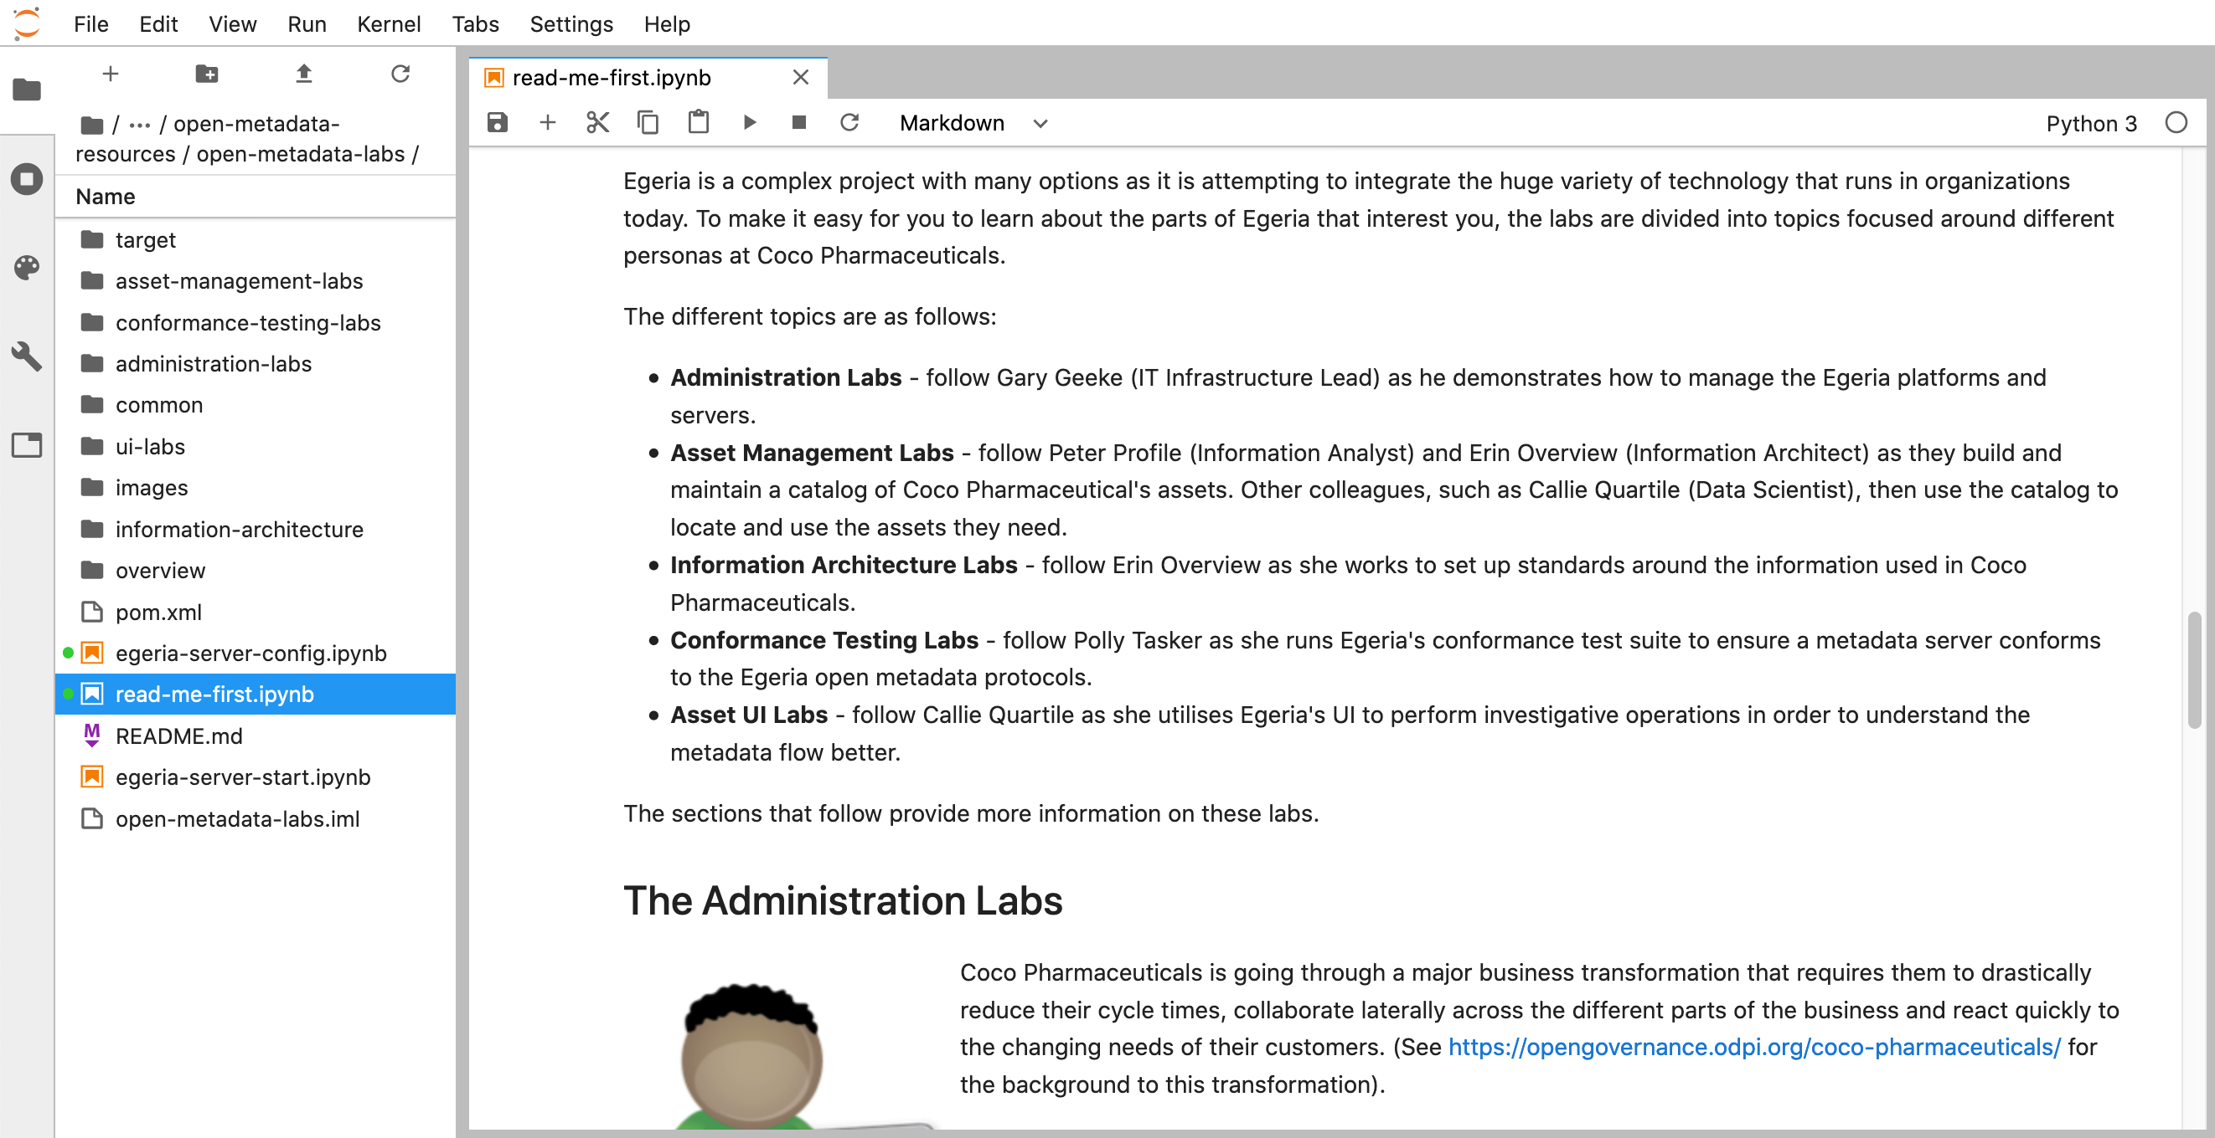
Egeria hands on labs
Persona based labs based on Coco Pharmaceuticals allow an individual to run Egeria through different scenarios

Slide 43
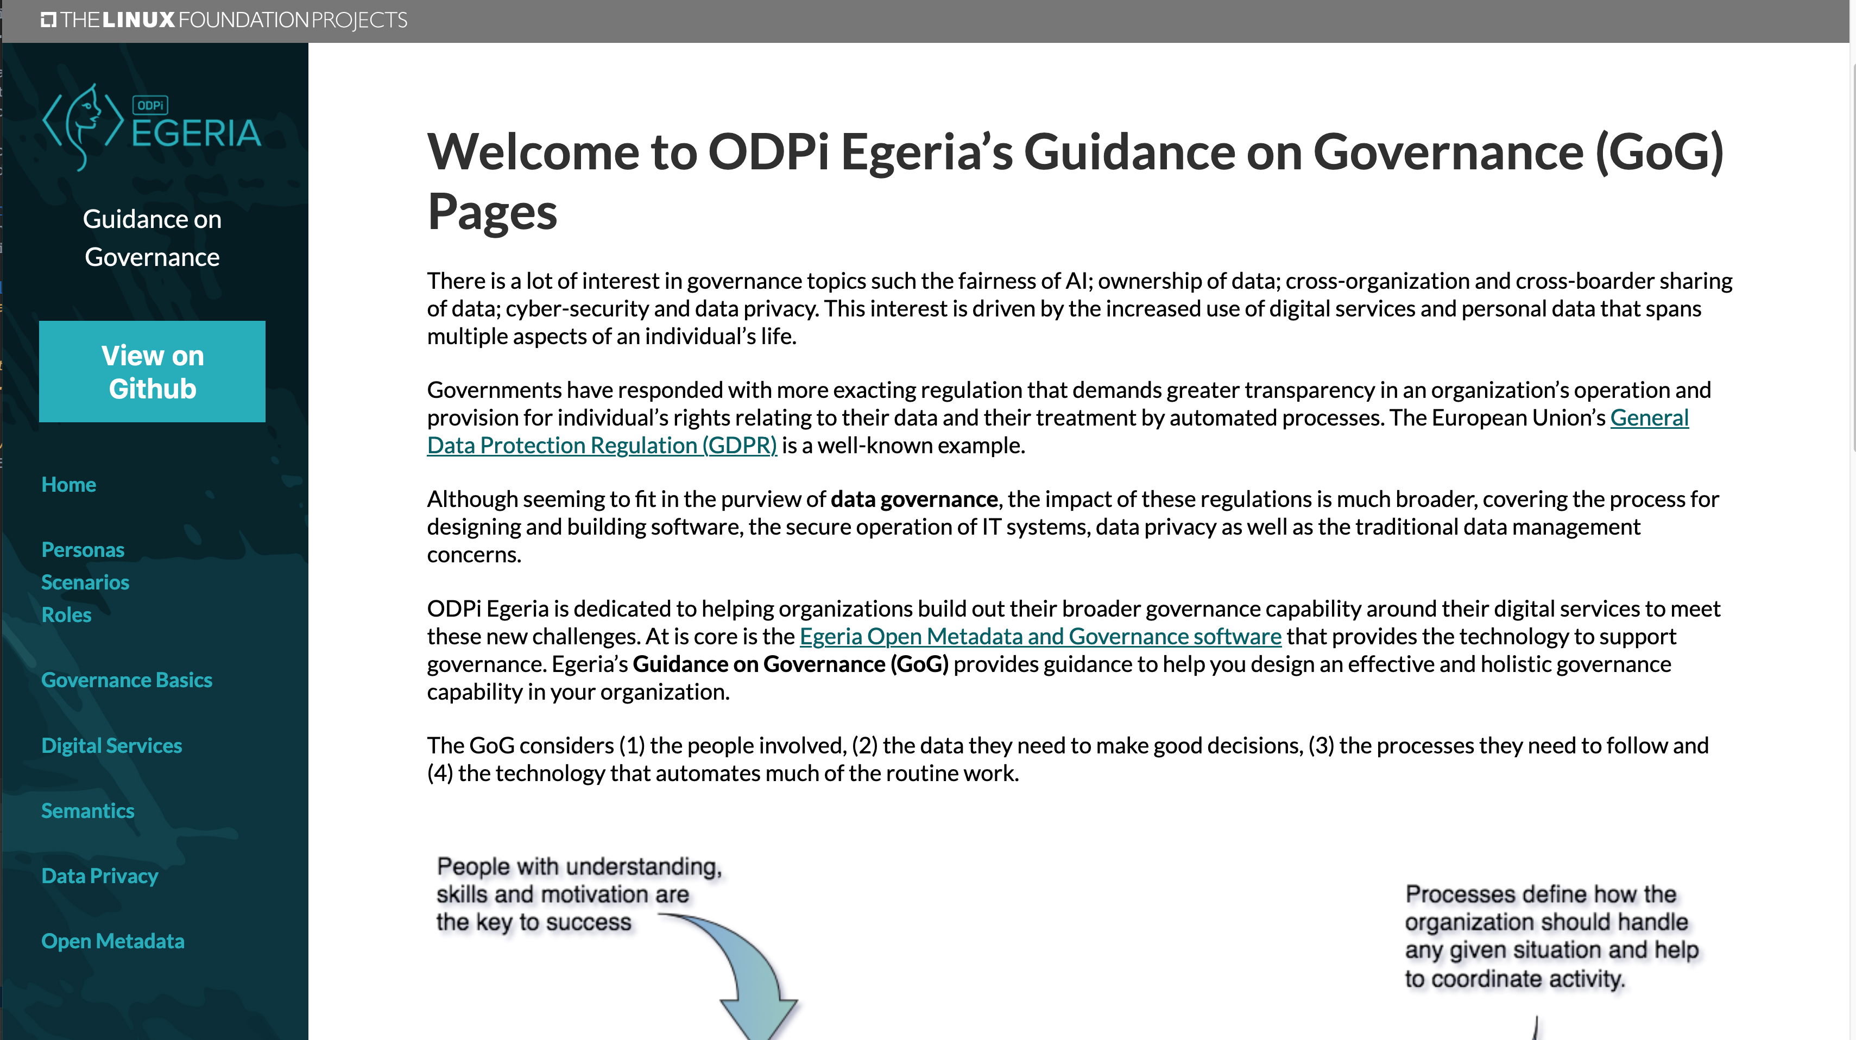
Guidance on Governance (GoG)
Governance Overview
Maturity Model
Digital Services Lifecycle
Coco Pharmaceuticals Scenarios

Slide 44
Open forum
z
z
z
z
z
z
z
Questions?

Slide 45
Links
Press Release and Podcast
Open source repositories
  https://www.linuxfoundation.org/press-release/2018/08/odpi-announces-egeria-for-open-sharing-exchange-and-governance-of-metadata/
  https://roaringelephant.org/2018/09/25/episode-107-open-metadata-and-governance-masterclass-with-mandy-chessell-part-1/
  https://roaringelephant.org/2018/10/09/episode-109-open-metadata-and-governance-
  masterclass-with-mandy-chessell-part-2/
  https://github.com/odpi/data-governance
  https://github.com/odpi/egeria

Slide 46
