Slide 1
LF AI & Data
November 26, 2020
John Mertic
Program Director, LF AI & Data
Jmertic@LinuxFoundation.org

Slide 2
Ecosystem Overview

Slide 3
Open Source AI & Data - Ecosystem Challenges
Glass ceiling for project investment and adoption
in the absence of a fair governance and safe haven for the project’s assets
1
Managing projects assets
As project grows, it is unclear who should own legal and administrative tasks that are essential to the health of the project
2
Developed for a specific product needs
The open source spinoff is a result of wanting to build an ecosystem and collaborate on building a platform
3
Governance challenges
No formal governance,
governance favors the creators of the project,
project backer dominating dev and governance
4
Fragmentation
Lack of integration
Lack of cross pollination across projects
5

Slide 4
We all are aware of the advantages of open source …
Access to source code
Ability to customize
Rapid development
Peer review
Improved quality and security
Reduce dev time and TTM
Flexible licensing model
Community driven innovation
Influence roadmap via participation
Transparent technical discussions
‹#›

Slide 5
But, Open Source offers unique benefits to AI & Data
Fairness
Methods to detect and mitigate bias in datasets and models, including bias against known protected populations
Robustness
Methods to detect alterations/tampering with datasets and models, including alterations from known adversarial attacks
Explainability
Methods to enhance understandability and interpretability by persona/roles in process of AI model outcomes/decision recommendations, incl ranking and debating results and decision options
Lineage
Methods to ensure provenance of datasets and AI models, including reproducibility of generated datasets and AI models
Open Data
Methods to clean, sort, tagg and track provenance and a governance structure for doing these things

Slide 6
LF AI & Data is an LF umbrella foundation that brings together the LF AI and ODPi communities to further support collaboration and the acceleration open source innovation in AI, ML, DL and Data.

Slide 7
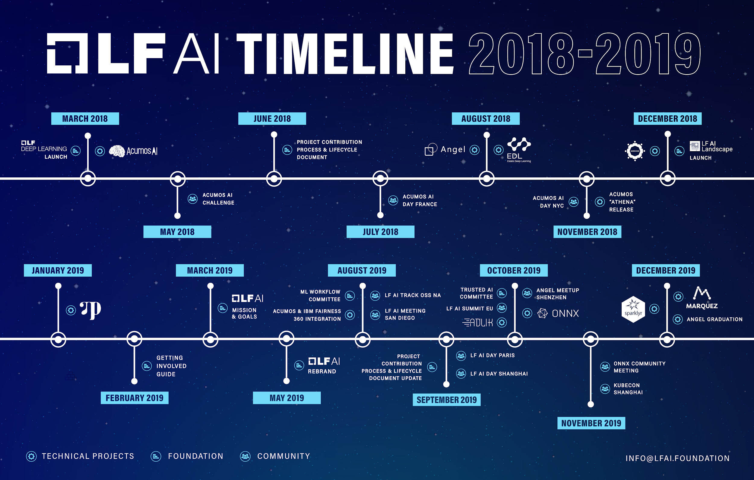
LF AI 2018 - 2019 Timeline

Slide 8
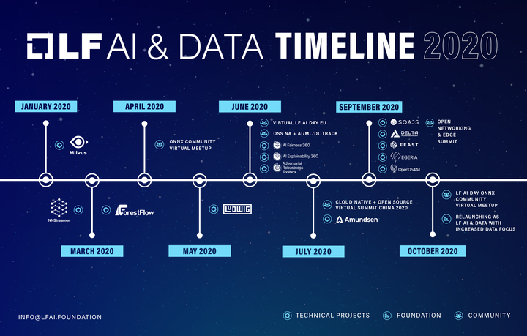
LF AI 2020 Timeline

Slide 9
LF AI and ODPi Combining Efforts in AI and Data
Combining efforts will:
Bring developers/data scientists and their projects under a single roof, served by a single Technical Advisory Council and several committees (Trusted AI, BI & AI, ML Workflow and InterOp), to work together towards building the open source AI & Data ecosystem and accelerating development and innovation.
Provide unified guidance for end users on tools, interoperability, integration, standards, and the future of AI, Data and Analytics as its use continues to grow in every industry.
Enables close collaboration, integration, and interoperability across projects - hosted within the same umbrella foundation - which is a proven, industry best practice recipe for building strong open ecosystems.
Allow greater efficiency for members across the various services we offer to hosted projects in the AI and Data domains.

Slide 10
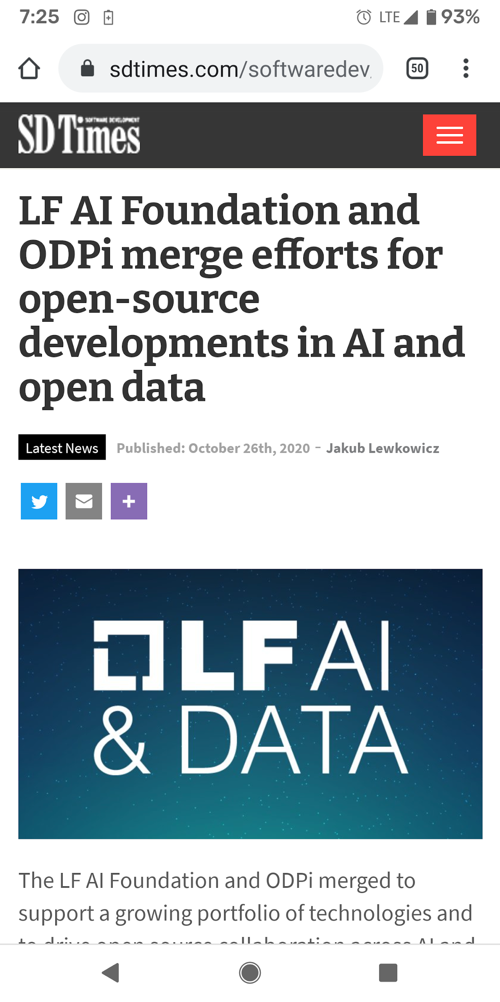
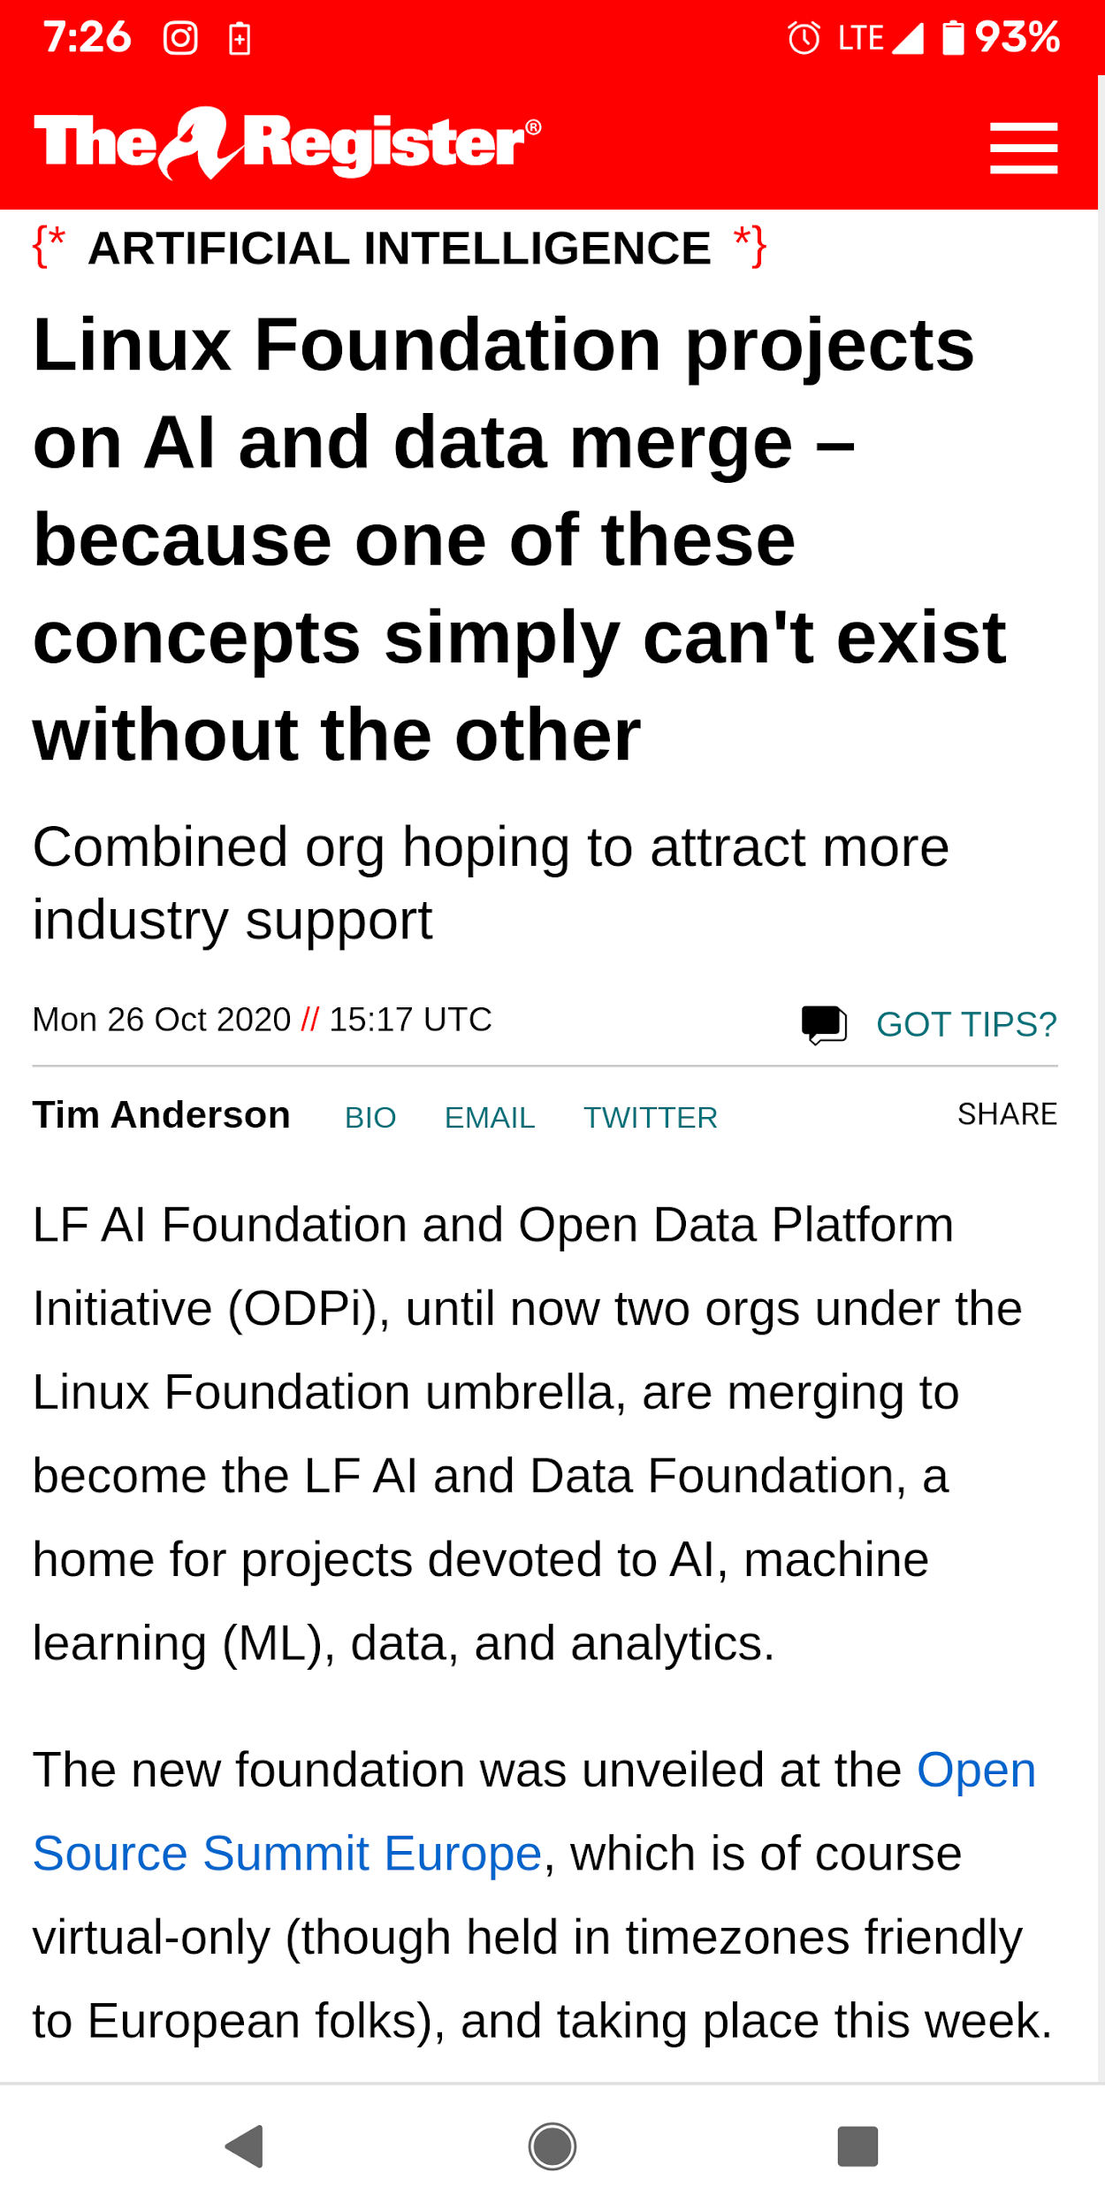
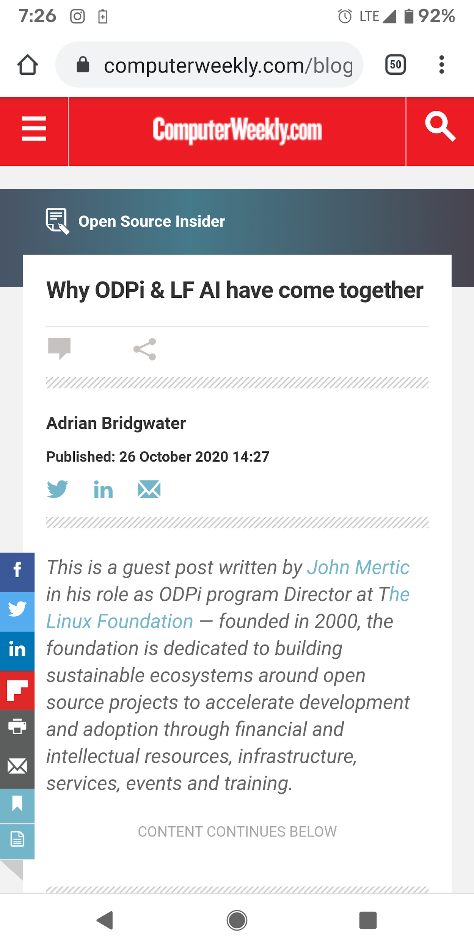
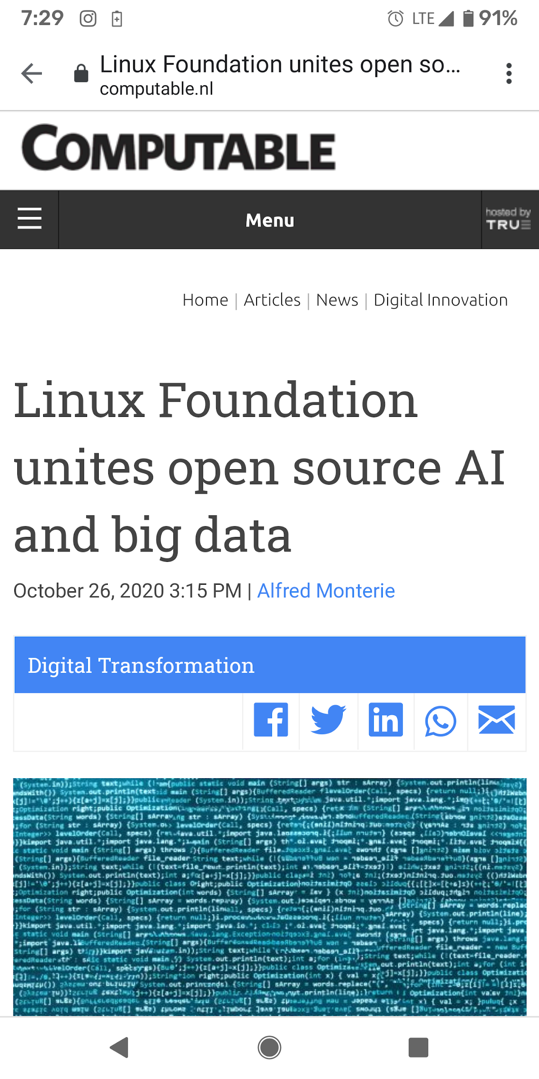
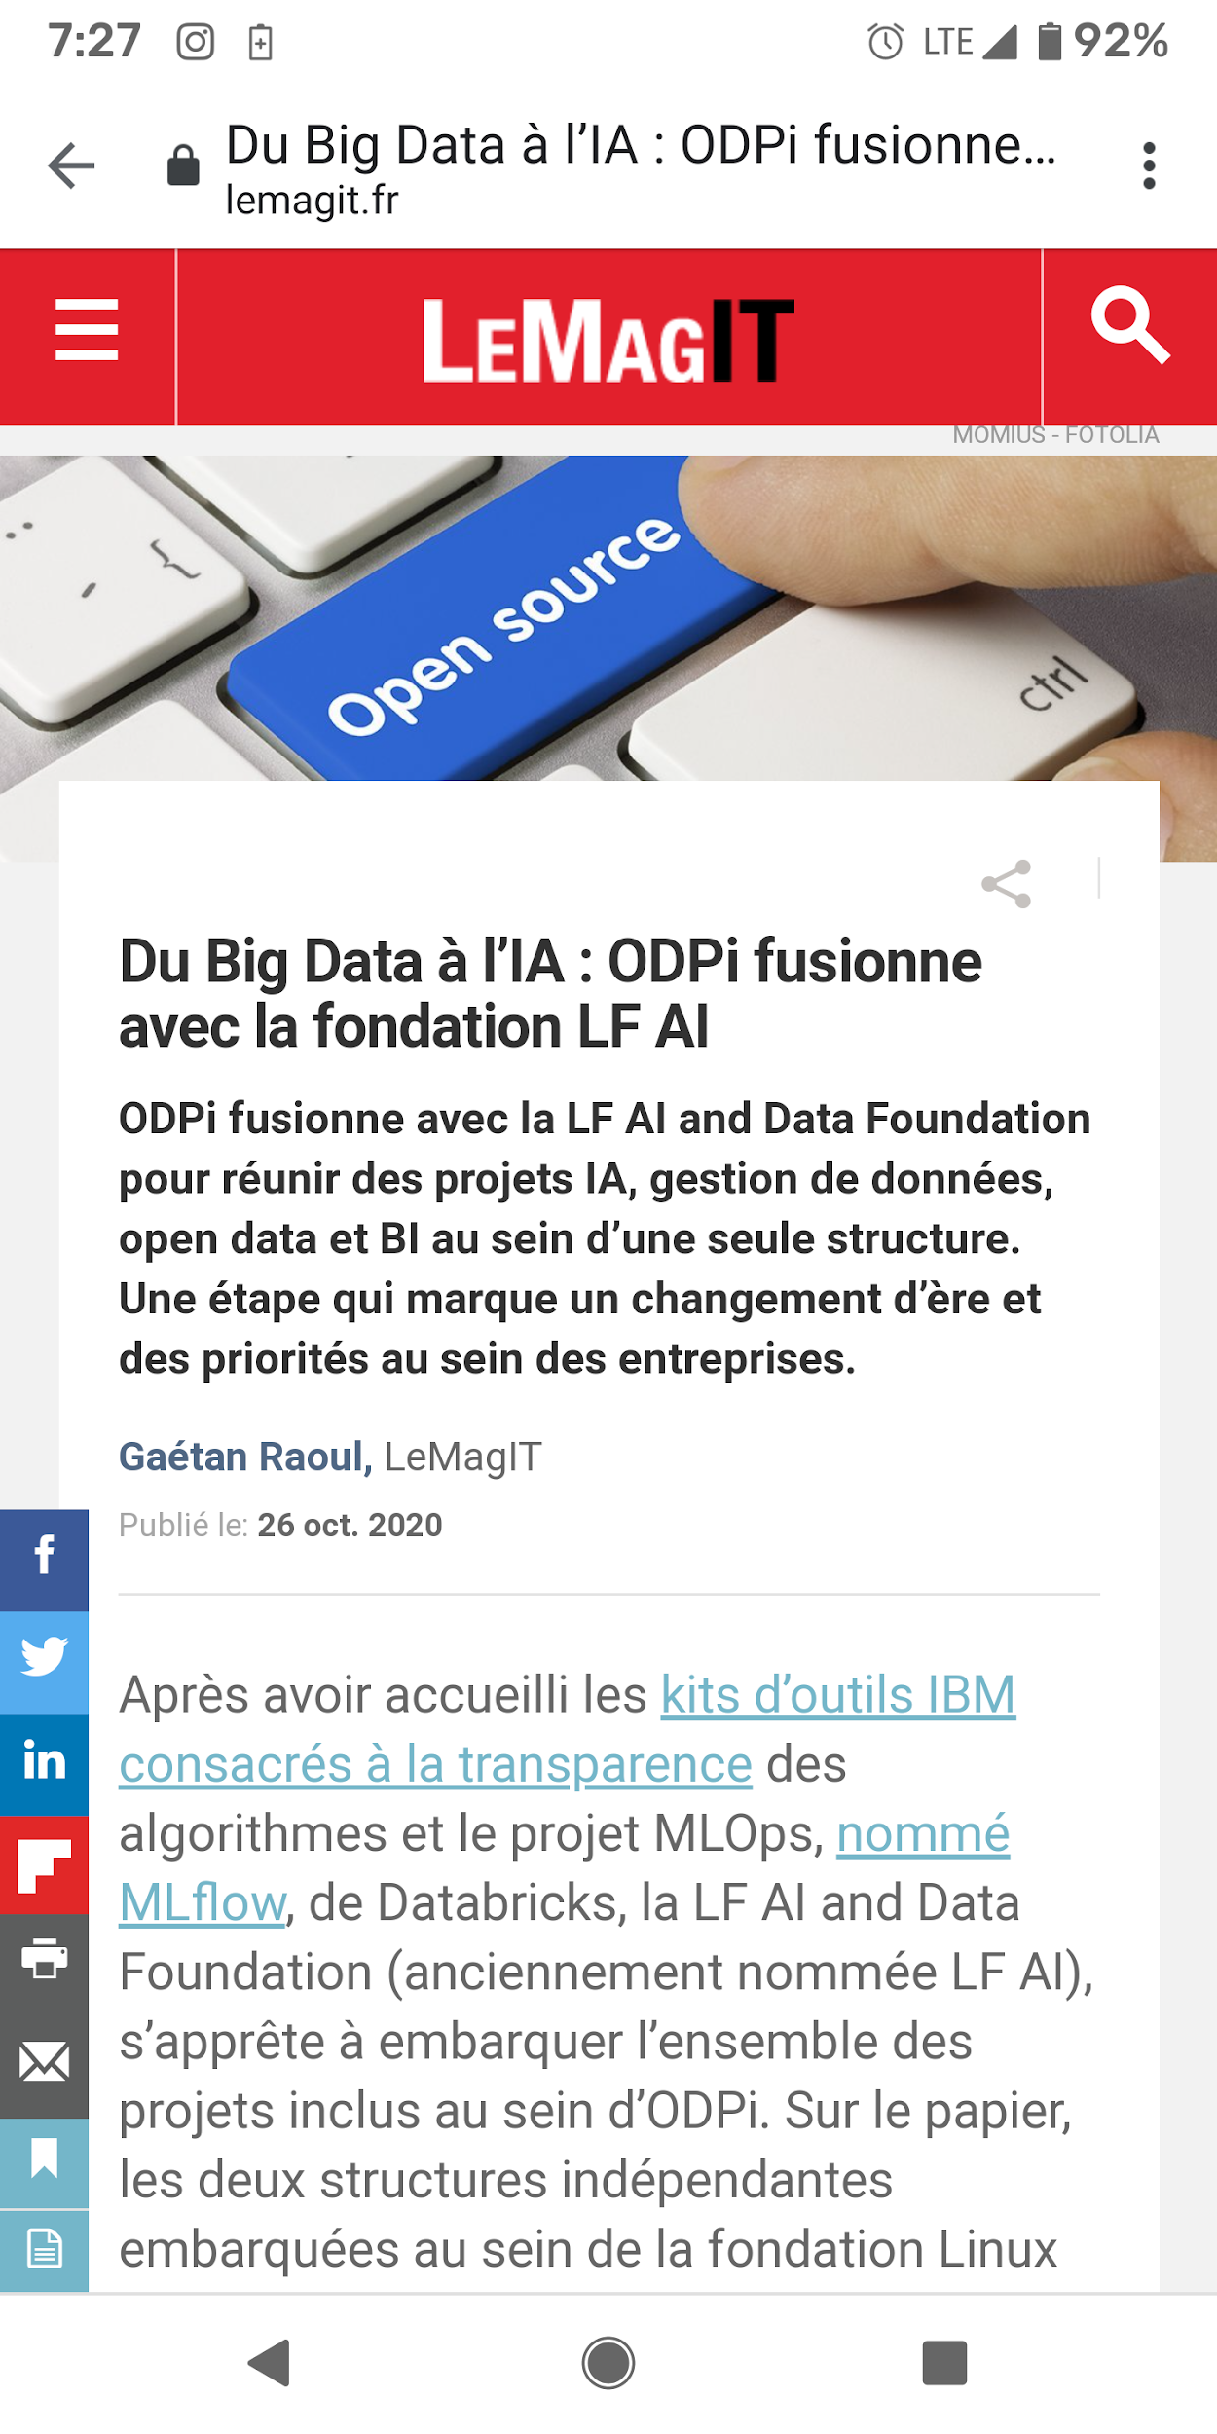
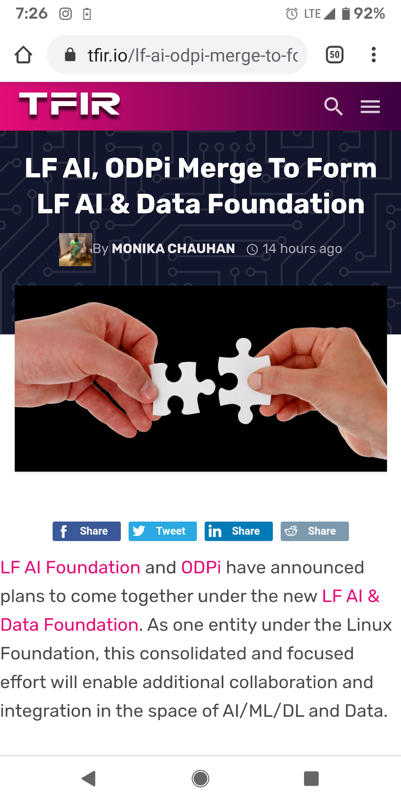
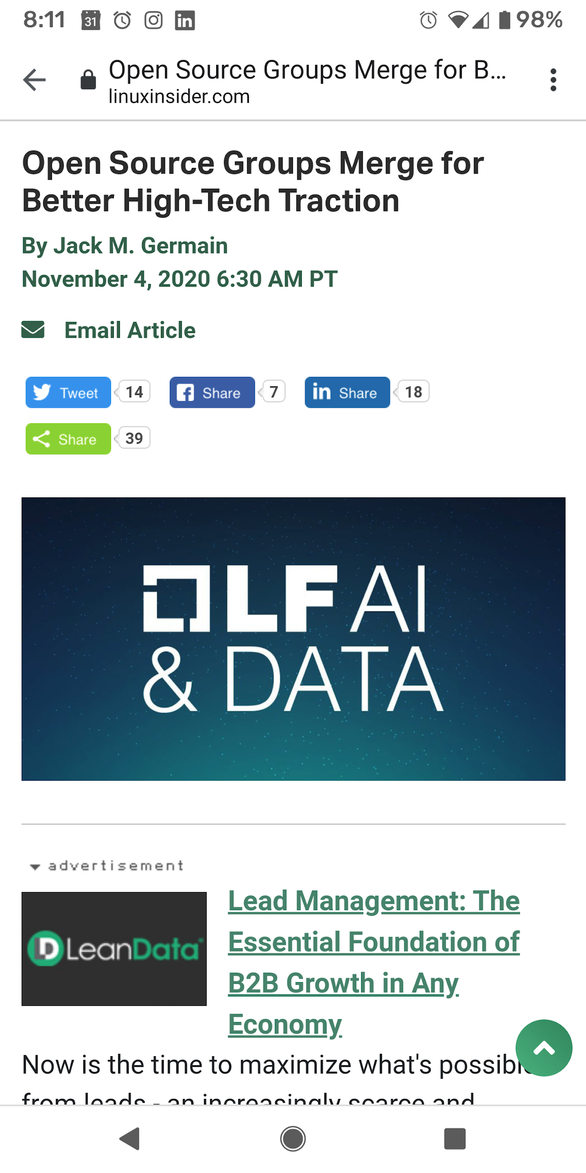
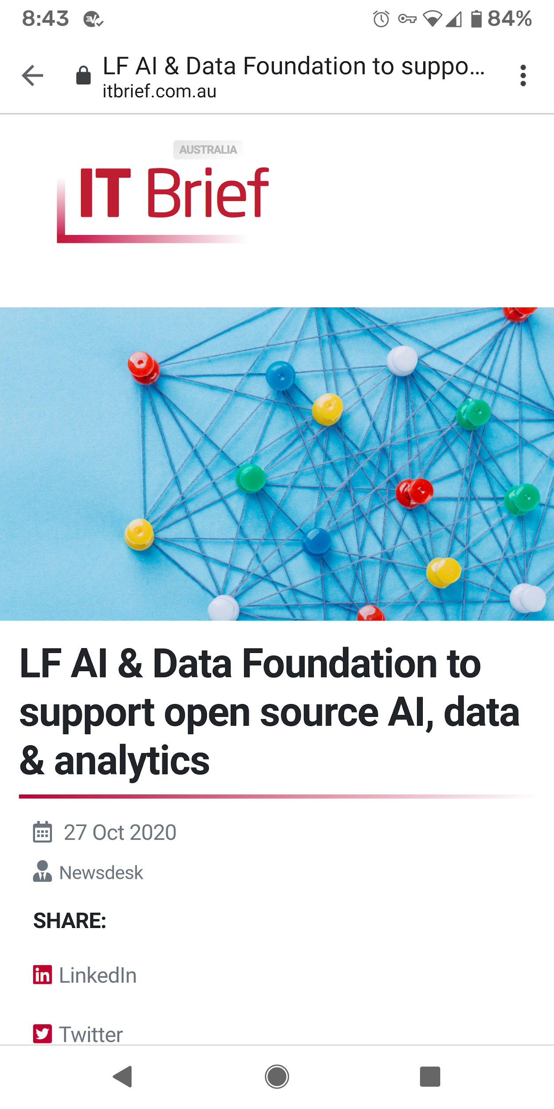
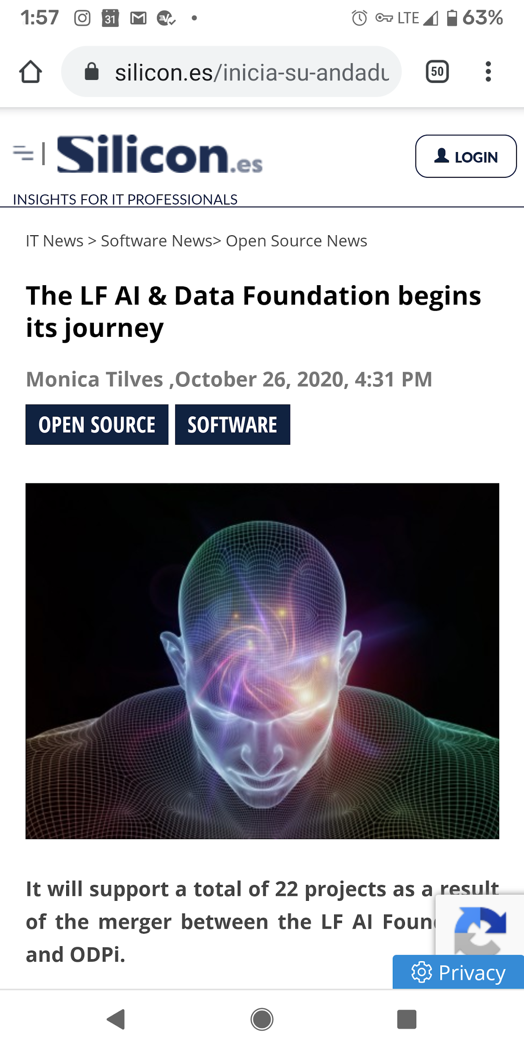
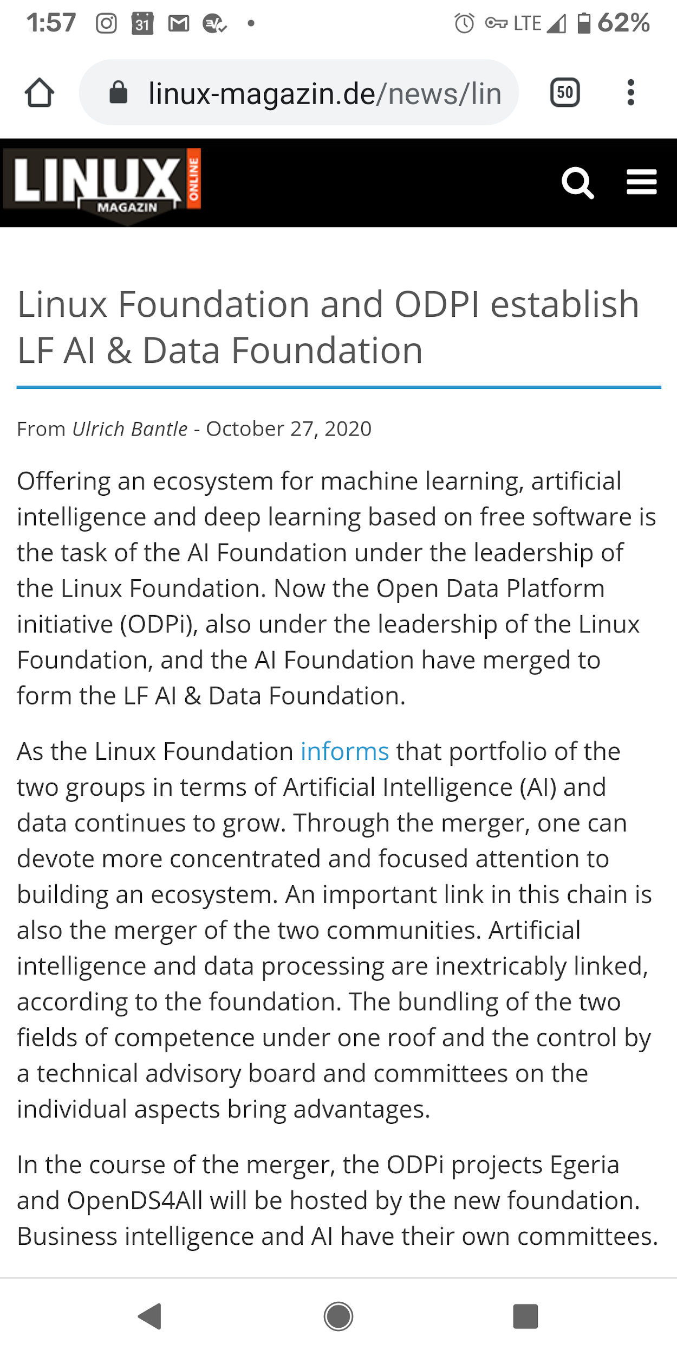
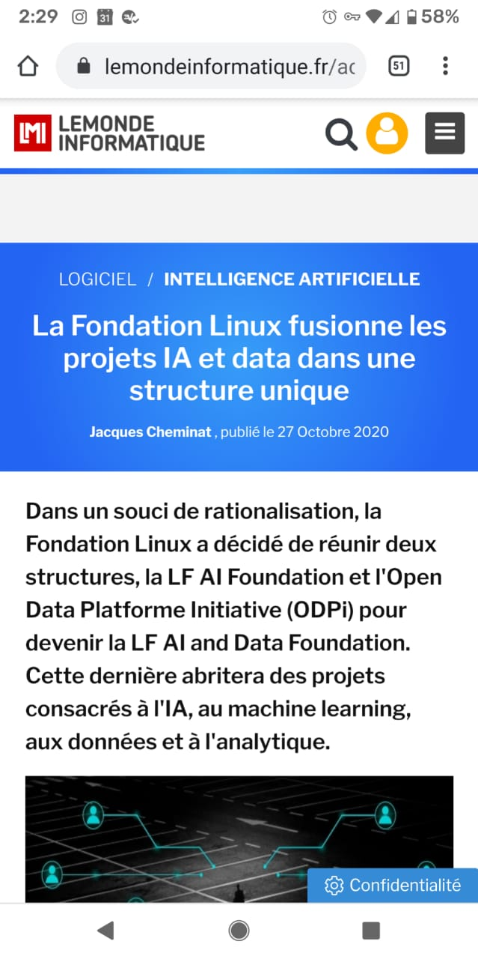
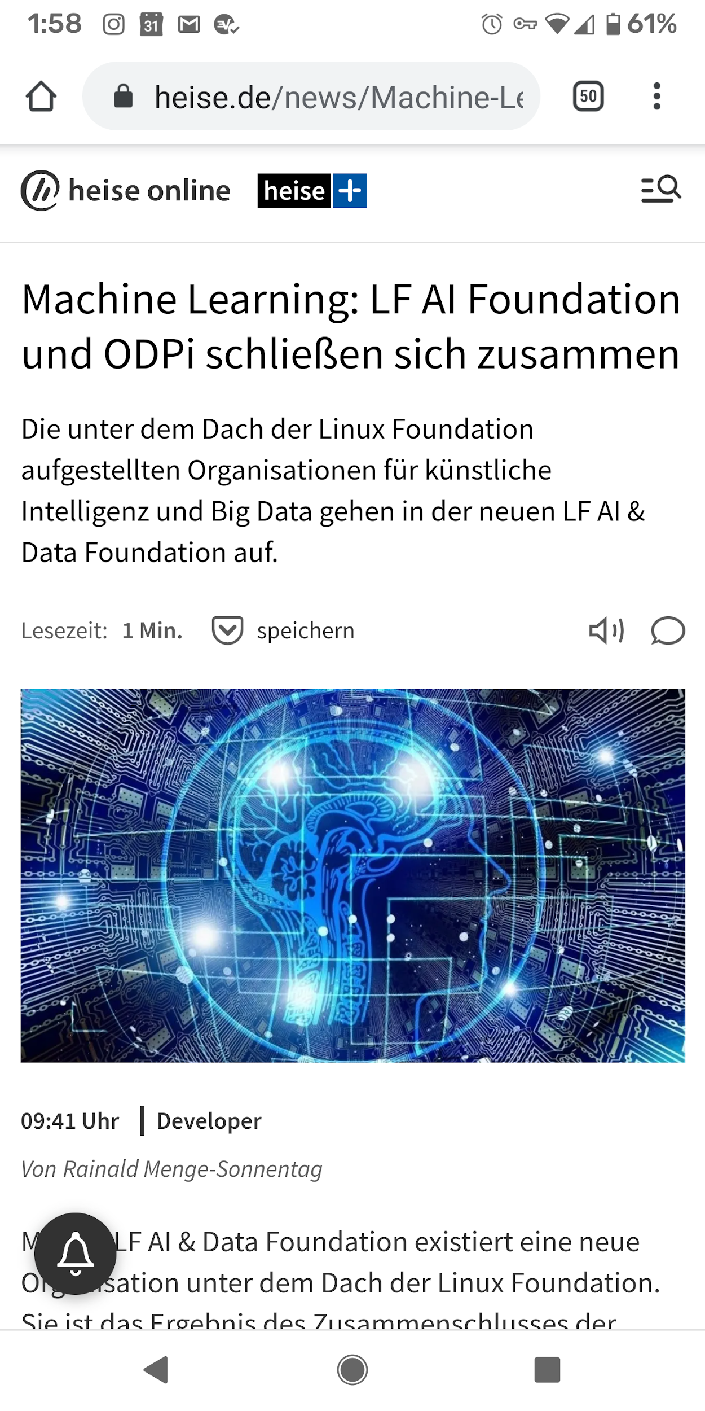
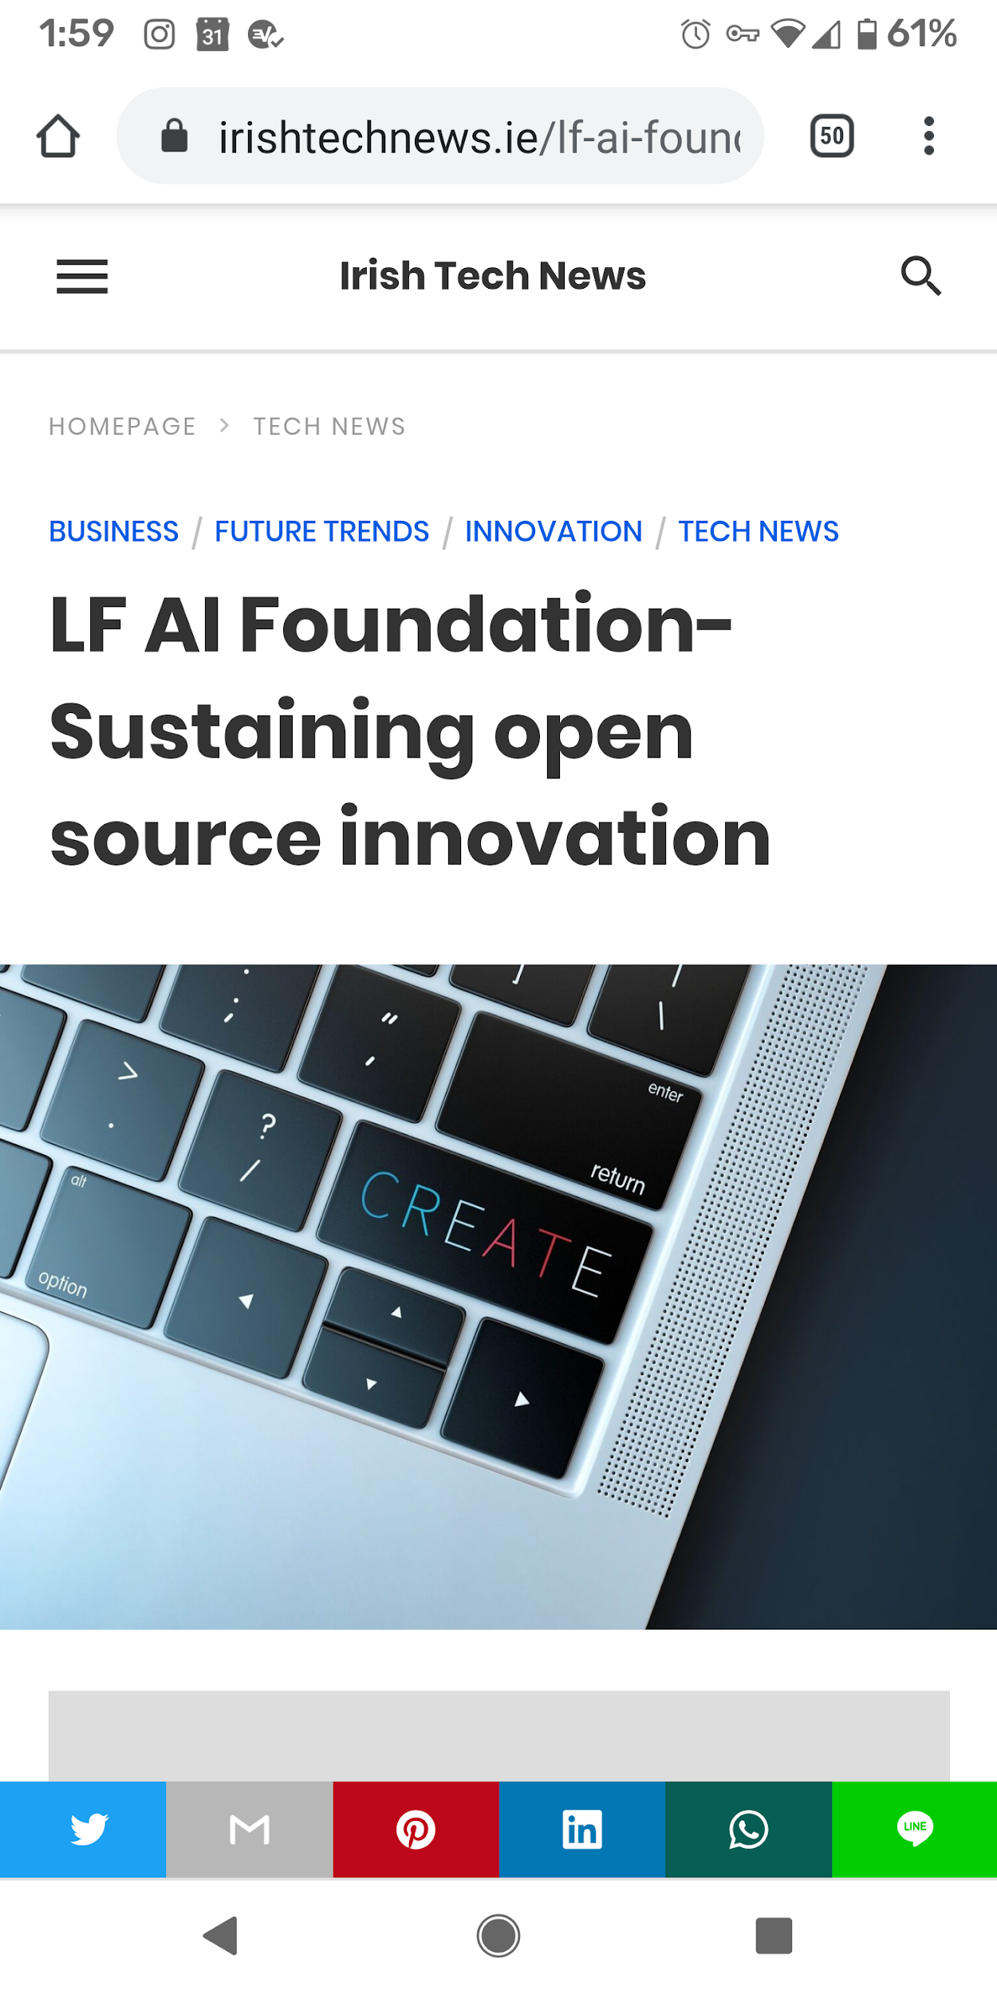
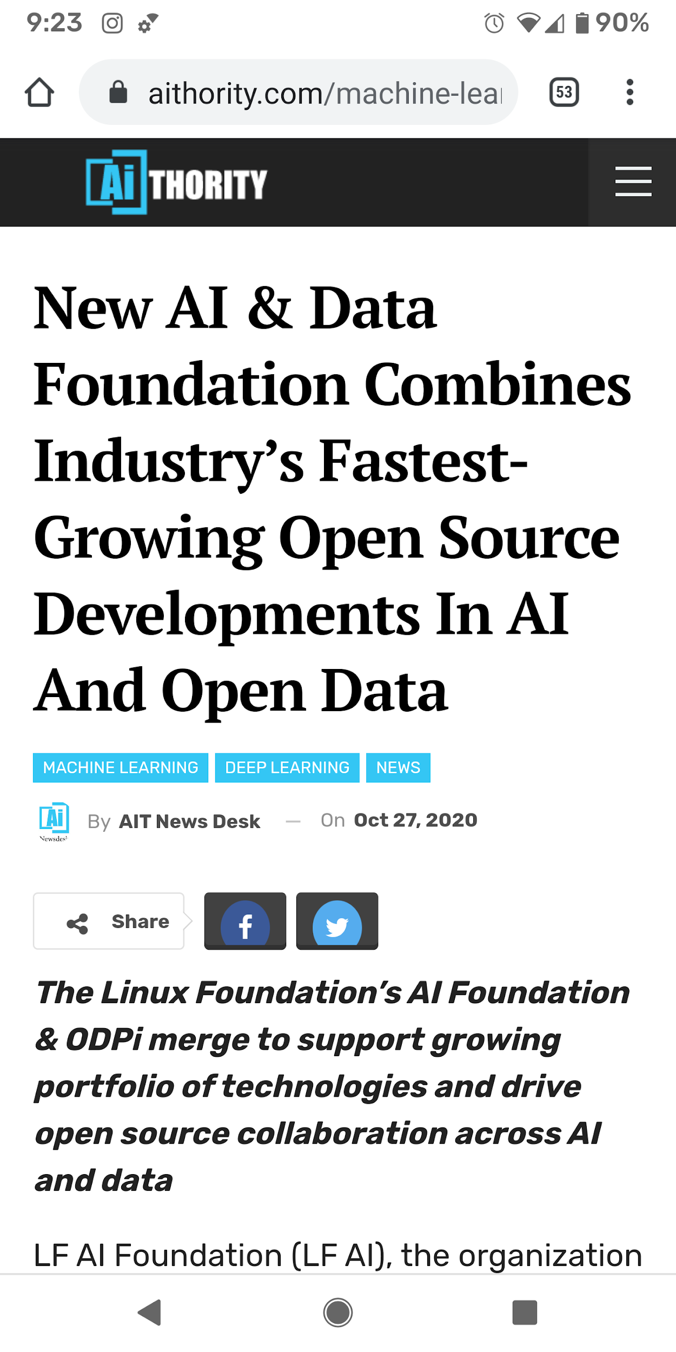

Slide 11
Mission
To build and support an open community and a growing ecosystem of open source AI, data and analytics projects, by accelerating innovation, enabling collaboration and the creation of new opportunities for all the members of the community

Slide 12
Motivations for Harmonization
Improving interoperability and capabilities across hosted projects
Enabling closer collaboration and integration, and the support of a single Technical Advisory Council
Providing unified guidance to end users on tools, interoperability, integration, and standards
Achieve greater efficiencies in support services for a growing number of hosted projects
Build a strong open source AI and Data ecosystem

Slide 13
Structure and Governance
Foundation Governance
Funding effort to support hosted technical projects
Technical Coordination, New Initiatives
Hosted Projects
Projects have their own independent technical governance
Governing Board
Technical Advisory Council
Outreach
Legal
ML Workflow & Interop
Trusted
AI
Committees
Strategy
Budget
BI & AI
‹#›

Slide 14
Major Efforts
Neutral Environment
Harmonization, Interoperability
Trusted and Responsible AI
Data
Model Marketplace
Funding and Awareness
Provide an neutral environment and an open governance that fosters collaboration and cross-pollination across projects and communities
Increase efforts to harmonize AI/ML/DL open source projects and reduce fragmentation;
increase interoperability among technical projects
Become the home of open source trusted and responsible AI, both at the level of technical projects and also at the level of principles and guidelines
Develop the only vendor neutral, open source standards to enable best practices for data governance, connectivity, business intelligence, and analytics.
Host open source models and provide supporting tools; publish best practices; offer a marketplace for AI/ML/DL models
Provide a funding model for key projects
Increase awareness via a number of marketing and outreach activities
Training courses published in edX
Vendol neutral
#
Not-for profit
#
Open governance
#
IP clarity
TAC
ML Workflow & Interop
#
Cross Foundation Collaboration
#
Integration efforts
Trusted AI Committee
#
3 Core Projects
#
edX Training
BI & AI Committee
#
Large number of Data hosted projects
Open Source Model marketplace
Funding model
#
LF AI & Data Days, LF AI & Data Summit
#
Services: Marketing, Legal, Events and PM
‹#›

Slide 15
Members
Premier
General
Associate
‹#›

Slide 16
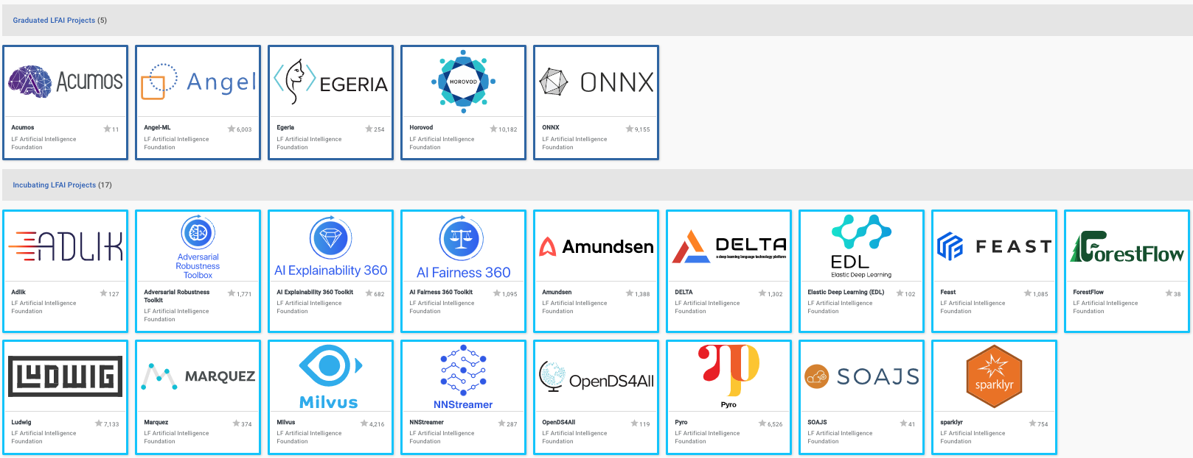
Projects
https://landscape.lfai.foundation/format=card-mode&project=hosted

Slide 17
What does it mean to be a Foundation project?
A neutral home for the project increases the willingness of developers from organizations to collaborate, contribute, and become committers
Endorsement by members of the LF AI & Data Technical Advisory Committee (TAC) is an independent signal of the quality of your project
Open and neutral governance model
Program and project management services
Access to full-time staff who are eager to assist your project
Access to marketing and communications services to support community and ecosystem engagement
Access to a full range of events services to help the project build and grow a community around it
Legal support ranging from hosting the trademark in a neutral organization to CLA and DCO system integration with GitHub, regular compliance scans, etc.
Presence across multiple geographies including China and Japan

Slide 18
Companies hosting projects in LF AI & Data
https://landscape.lfai.foundation/format=hosting

Slide 19
Why these top companies host with LF AI & Data?
The Linux Foundation is the leading commons for community assets
The Linux Foundation (LF) is a recognized and respected brand and can activate communications across tech, business, and social media channels.
The LF is the largest open source foundation, providing management of community assets for over 400 projects:
Over 3,400 source code repositories.
Over 700 trademark registrations and applications, plus hundreds of unregistered marks.
Over 700 project domains and DNS records.
Over 12,000 Contributor License Agreements signed for project communities that decide to require one.
The LF offers neutral sponsorship for managing fundraising.
Over 1,600 unique member company relationships.
Our communities raised over $100 million in 2019 via 6,500+ invoices.
Our communities spent funds in 180,000+ separate transactions in 2019.
The LF reports its audited financials to its board.

Slide 20
Why incubate with us?
Building large, sustainable ecosystems requires collective resources
Events - We gathered over 45,000 attendees from over 12,000 organizations across 113 countries in 2019.
Legal - We manage IP for the world’s most important tech and have one of the world’s top open source legal teams in house.
Training - We trained millions of students (free and paid online), online skills certification, and on-site e-learning.
Certification - We designed and executed software and hardware testing and certification programs.
Developer Marketing - We have the largest share of voice of any open source foundation and a proven method to build large scale developer programs.
Developer Operations - We host the infrastructure that develops the world’s largest software communities and provide release management, IT ops, and support.
Application Security- our projects are regularly audited and pen tested. We offer bug bounties, dependency analysis, and code scanning.

Slide 21
Strong LF AI & Data Marketing/PR Effort
37 announcements between LF AI and ODPi in 2019
27 announcements between LF AI and ODPi in 1H 2020
Events announcements and promotion
Project release
Project incubation
New members joining
Project cross collaboration
Invited posts
LF AI provides marketing services to support community and ecosystem engagement.
Content ranging from the LF AI blog, white papers, posters, presentations, and more
Oversee blog editorial calendars and writing, editing, and/or identifying and funding freelancers to develop content
Help develop the project website and other required creative work

Slide 22
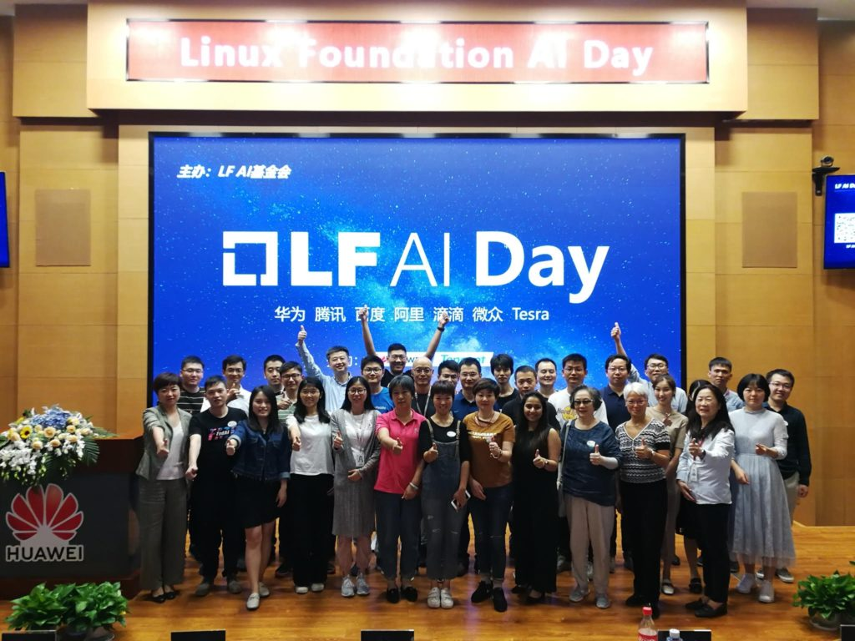
Events and Community
LF AI & Data Summit - co-located event with major LF conferences + Booth
LF AI & Data Track at Open Source Summit (NA, EU, China) - Supporting 18-20 talks over 3 days + Booth
LF AI & Data Days - a whole day (in person and virtual) hosted in collaboration with an LF AI & Data member with audience ranging from 50-250. Multiple/year.
Talks at other leading industry events and regional events ( All Things Open, Data Con LA, Big Data Conference Europe )
Project specific events
Sponsorship and booth at KubeCon
Strong presence & event participation in China

Slide 23
Incubating Projects
TAC committee is responsible to voting in new incubation projects.
The TAC meets bi-weekly and generally booked 4-6 weeks in advance.
Proposing projects for incubation

Slide 24
Joining LF AI & Data is Easy!
General Inquiries:
info@lfaidata.foundation
‹#›
Notes:
Thank you for joining Big Data Conference 2020. I want to inform you that you will get the session recordings in the following weeks.
I hope you had a great time during these days, got inspired, learned about the latest trends in the field. All you need now is to put the new-learned skills to action.
Thank you once again for joining. Stay healthy! See you next year!”

