Slide 1
bigdata 2020
REAL TIME STREAM PROCESSING
CRISTIAN PREVEDELLO
CHIEF ARCHITECT @ PREVINET

Slide 2
WHO WE ARE
OUTSOURCING COMPANY
4 DIFFERENT BUSINESS UNITS
Insurance & banking
Pension funds
Finance
Healthcare
~ 300 active projects
~ 100 different customers
HYSTORICALLY A PURE JAVA SHOP
WEB ACID APPLICATIONS DEPLOYED IN JAKARTA AS
BATCH APPLICATIONS

Slide 3
WHAT WE DO
PROCESS DATA FILES IN BATCH MODE
SEQUENTIAL PROCESSING INTO RELATIONAL DBs
ETL FROM RELATIONAL DBs
TARIFF
PENSION SIMULATIONS
DOCUMENT GENERATION
AI/ML COMPONENTS
NATURAL LANGUAGE PROCESSING
OCR and TEXT EXTRACTION
DOCUMENT CLASSIFICATION
IMAGE RECOGNITION

Slide 4
WHAT WE DO
FEED OUR LOG MANAGEMENT SYSTEM
COLLECT LOGS & STRUCTURE LOGS
ENABLE APM WHEN NOT AVAILABLE OUT OF THE BOX
OPERATE OUR SOC
CORRELATE LOGS & EVENTS
SECURITY ALERTS

Slide 5
PROBLEMS WE HAD
DATA SIZE INCREASED OVERTIME
CUSTOMER SLAs GOT MORE CHALLENGING
PROGRESSIVE SHIFT FROM BATCH TO (near) REAL TIME
SYNCHRONOUS INTERACTIONS
UNABLE TO ADOPT NEW TECHNOLOGY
HARDER TO SCALE QUICKLY/UNABLE TO MANAGE REQUEST SPIKES

Slide 6
THE CURE (ALMOST)
WE TRIED WITH HADOOP IN 2014/2015
SCALA SPARK JOBS TO RUN ETLs….
… BUT HEAVY WEIGHT
EXPENSIVE TO OPERATE
DEDICATED SYSTEM FOR THESE ACTIVITES
EXPENSIVE TRAINING
TROUBLESOME TO INTEGRATE IN OUR REGULAR APPS

Slide 7
THE CURE
WE WANTED
SOMETHING SIMPLE & THIN
THAT COULD RUN ALSO REGULAR WORKLOADS AND NOT JUST “BIGDATA” STUFF
THAT COULD BE INTEGRATED IN OUR REGULAR APPS
THAT COULD SUPPORT OUR TRANSITION TO MICROSERVICES & DDD
THAT COULD RUN DIFFERENT STACKS & LANGUAGES

Slide 8
THE CURE
TOOLS+SERVICES+LIBS+GUIDLINES+BEST PRACTIES
WRAP EVERYTHING INTO A CONTAINER
RUN EVERYTHING ON KUBERNETES
USE KAFKA TO EXCHANGE MESSAGES AND EVENTS
PROMOTE AS MUCH AS POSSIBLE ASYNCHRONOUS COMMUNICATIONS
APPLY DATA PIPELINES & STREAM PROCESSING…
… AND REQUEST/RESPONSE STYLE
BREAK APPLICATIONS INTO “MICROSERVICES”

Slide 9
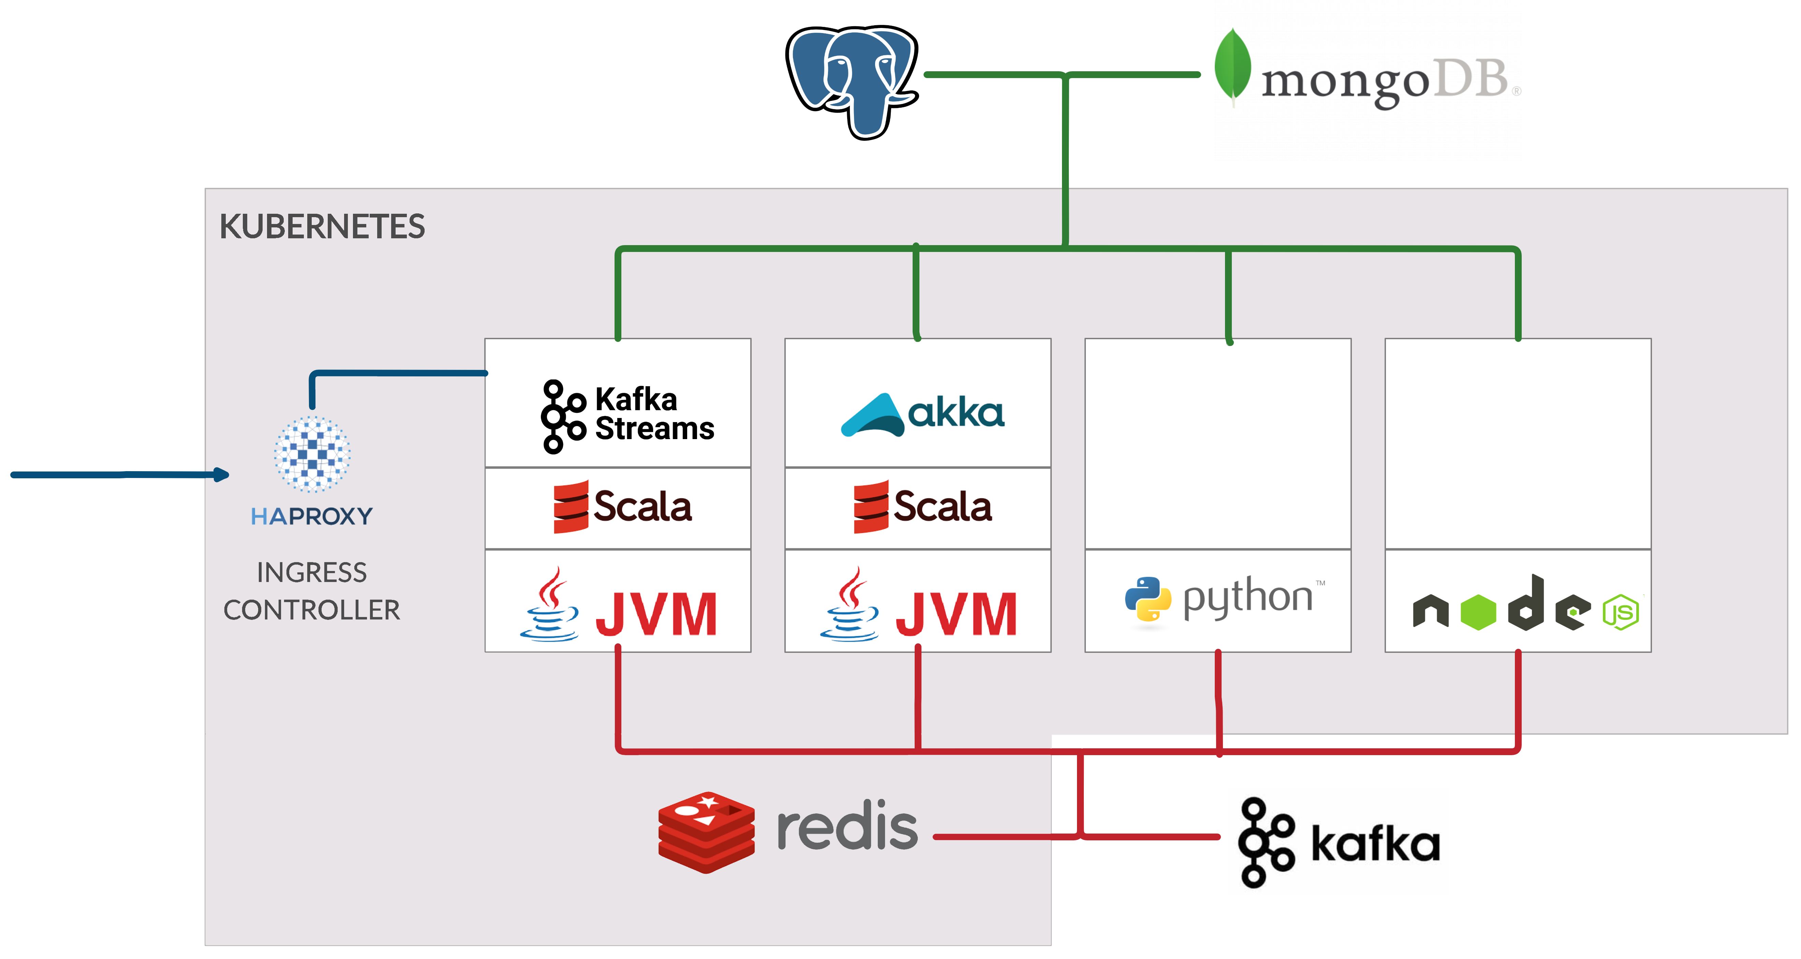
THE PLATFORM

Slide 10
«THE PLATFORM»
REQUEST/INPUT TOPIC
RESPONSE/OUTPUT TOPIC
DIFFERENT TOPICS FOR BATCH and REAL-TIME REQUESTS
RECOVERY TOPICS for FAILED PROCESSING WITH INCREASE RETRY TIME
KAFKA STREAMS STATE STORE USED TO ACCOMULATE RESULTS & DISCARD DUPLICATES
REPARTITION AS LATE AS POSSIBLE

Slide 11
OUR STACK
SCALA + KAFKA STREAMS
STATEFUL PROCESSING
ORCHESTRATION OF DATA PIPELINES
RESILENCY OUT OF THE BOX BY KAFKA-STREAMS
EASY PARADIGM TO GRASP
NOT APPLICABLE FOR LONG RUNNING TAKS
NOT APPLICABLE FOR I/O BOUNDED TASKS
CAN EASILY SCALE HORIZONTALLY WITH A NETWORK COST

Slide 12
OUR STACK
SCALA + AKKA + ALPAKKA
DEDICATED FOR SKILLED DEVELOPERS
APPLICABLE FOR LONG RUNNING TAKS
APPLICABLE FOR I/O BOUNDED TASKS
APPLICABLE FOR ASYNCRONOUS JOBS
CAN SCALE VERTICALLY WITHIN SAME INSTANCE WITH ACTORS
PARALLEL PROCESSING WITHIN SAME PARTITION

Slide 13
OUR STACK
PYTHON
FOR ML/AI RELATED PROCESSING
KAFKA-PYTHON LIBRARY
GLOBAL INTERPRTER LOCK PROBLEMS
ONE INSTANCE PER PARTITION
COMMIT every 100ms
DISCARD OLD MESSAGES

Slide 14
CONNETORS
USUALLY FOR HEAVY I/O BOUNDED TASKS
HIGH PERFORMANCE & LOW RESOURCE CONSUMPTION
BASED ON SCALA/AKKA STACK
CONNECTORS FOR
MONGO
POSTGRESQL
FTP
FILE
PROXY FROM/TO REST SERVICES

Slide 15
KAFKA PROXY
PROVIDE A REST API TO WRITE MESSAGES WITH KAFKA TOPICS
POST A MESSAGE in JSON
POST A MESSAGE in JSON + MULTIPART BINARY FILES STORED IN REDIS
FIRE&FORGET
WAIT FOR REPLY (POLLING)

Slide 16
QUERY AGENT
EXECUTE QUERIES ON DEMAND ON RELATIONAL & MONGO DATABAES
EXECUTE SCHEDULED QUERIES
ONE MESSAGE PER QUERY or…
ONE MESSAGE PER ROW

Slide 17
KAFKA DETAILS
KEY FORMAT
{PROTOCOL_VERSION}_{ACTION}_{EVENT/MESSAGE_ID}
MESSAGE FORMAT:
JSON (UGH!)
NO SCHEMA REGISTRY
CONSUMERS ARE FLEXIBLE ON MESSAGE STRUCTURE
AGILE & FAST DEVELOPMENT
JSON OVERHEAD

Slide 18
GUARANTEES
AT LEAST ONCE
EXACTLY ONCE CAUSED PROBLEMS ON PYTHON CONSUMERS
DOESN’T WORK ALL THE TIME
DEDUPLICATION ON ORCHESTRATORS
RESORT TO EXTERNAL DATABASE WITH IDEMPOTENT WRITES
QUALITY GATES TO IDENTIFY WRONG RESULTS
REPROCESS FROM SCRATCH

Slide 19
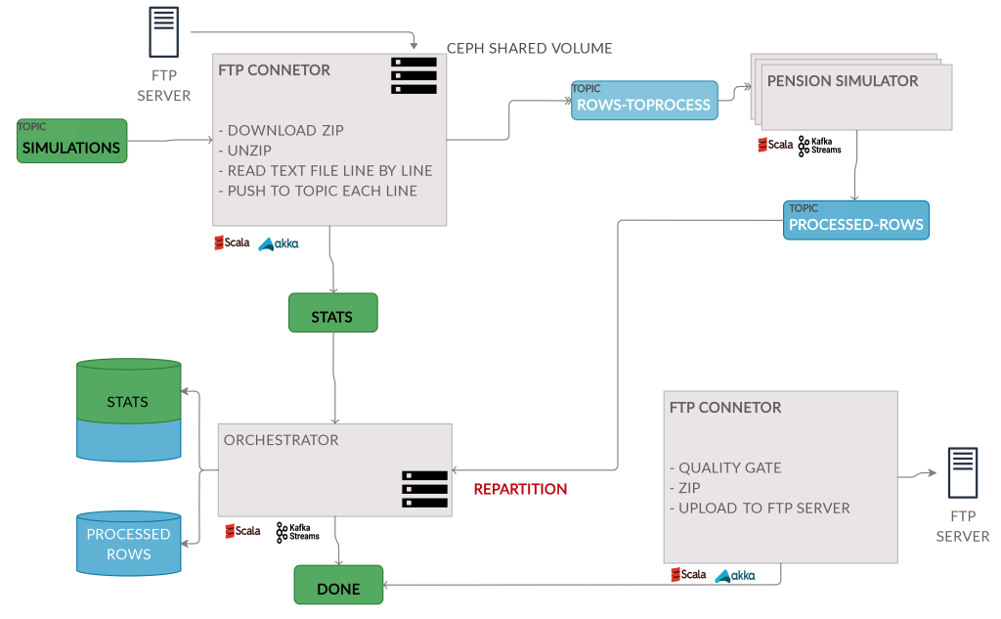
ETL

Slide 20
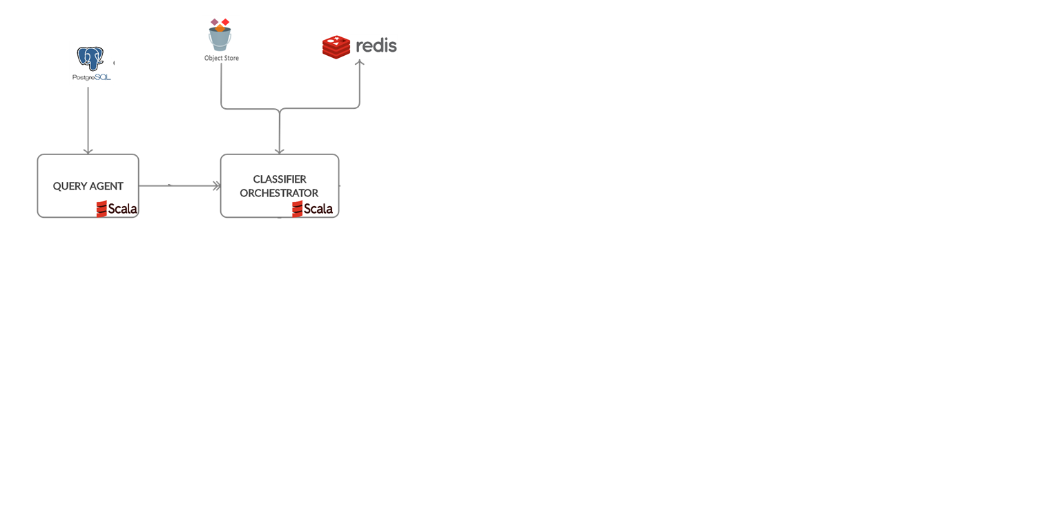
DOC CLASSIFICATION

Slide 21
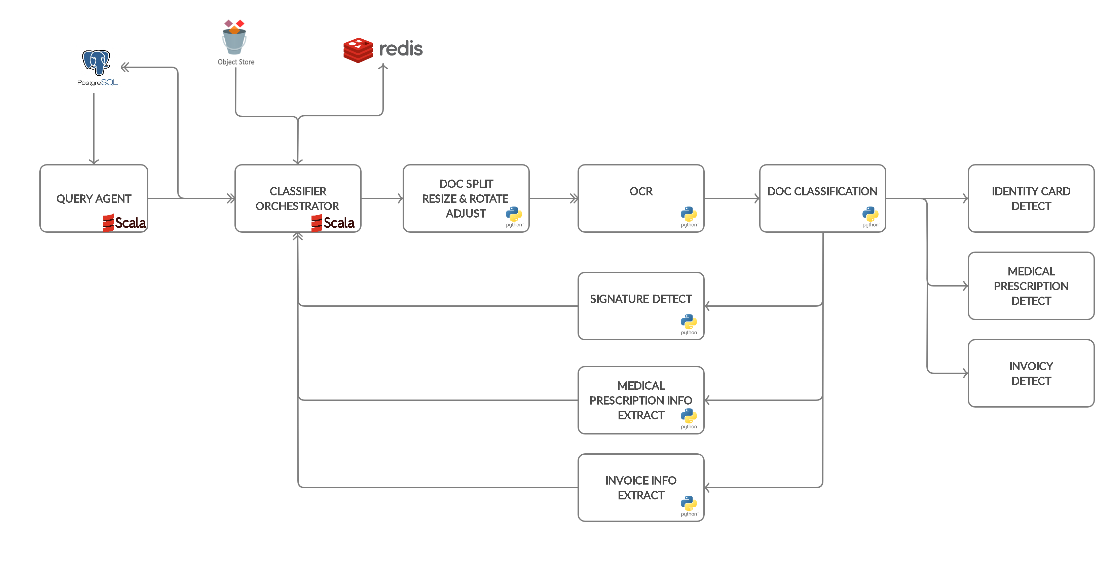
DOC CLASSIFICATION

Slide 22
DOC CLASSIFICATION

Slide 23
DOC CLASSIFICATION
ALL MESSAGES ARE ROUTED BY THE ORCHESTRATOR
STATEFULSET WITH UNIQUE CONSUMER GROUP for a «PUBLISH ALL» STRATEGY

Slide 24
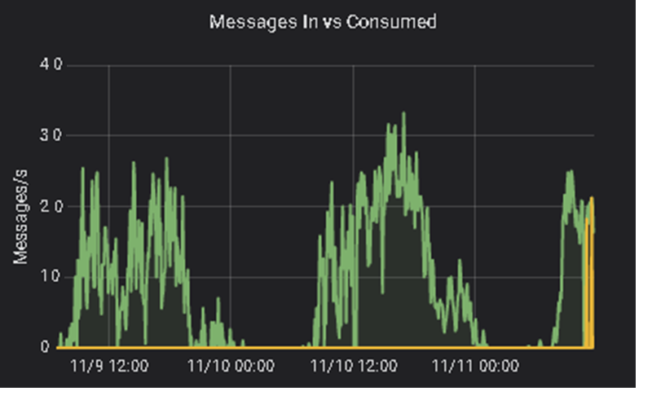
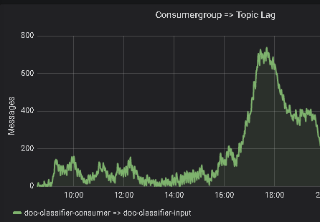
DOC CLASSIFICATION
20-30 PARTITIONS IN KAFKA, 100 commits/s
2 ORCHESTRATOR INSTANCES, up to 20/30 INSTANCES for EACH SERVICE
40k documents, 70k pages processed on a average in a day
KEEP TOPICS SMALL – NO MONOLITH – REPLICATE THE STACK

Slide 25
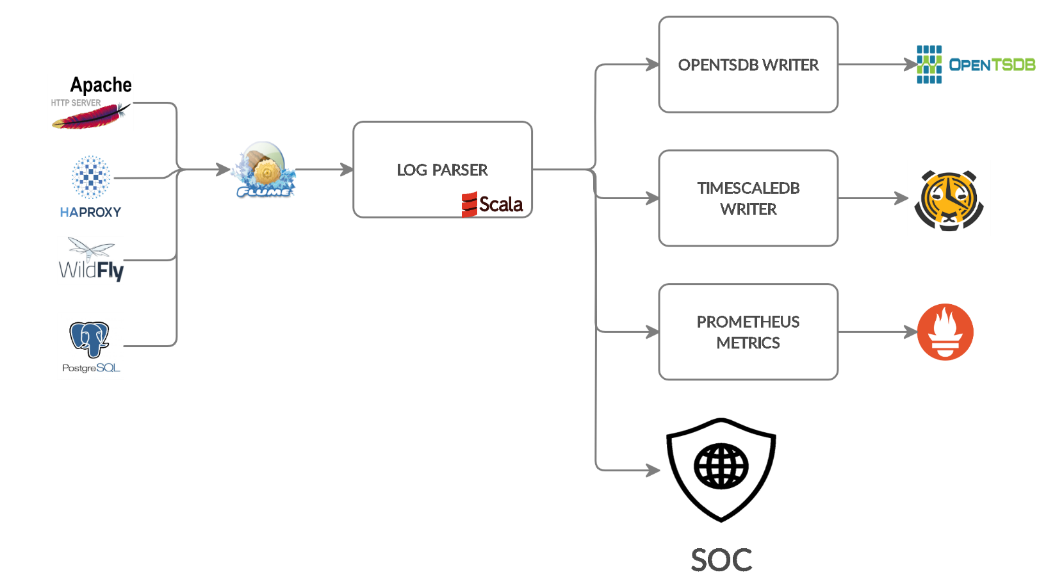
LOG MANAGEMENT
AGGREGATIONS
GROUPING BY WINDOWS

Slide 26
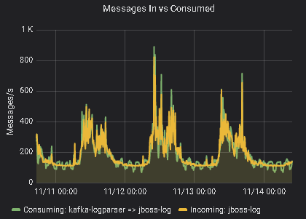
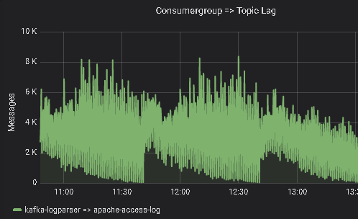
LOG MANAGEMENT
10 PARTITIONS IN KAFKA
4 INSTANCES for EACH SERVICE
GLOBALLY 2k/3k log lines/seconds

Slide 27
CUSTOMER ASSISTANCE PLATFORM x HEALTHCARE
USERS CAN
BOOK and MANAGE A VISIT WITH A DOCTOR
ASK FOR SOME INFO
ASK FOR A REIMBURSEMENT
PROVIDE FEEDBACK ON THEIR EXPERIENCE
THE PLATFORM
EVENT BASED ARCHITECTURE
SENDS REMINDERS
PROVIDE SUGGESTIONS BASED ON USER PREFERENCES

Slide 28
CUSTOMER ASSISTANCE PLATFORM x HEALTHCARE
WEATHER SERVICE WRAPPER
RECOMMENDER SYSTEM
MAPS SERVICE WRAPPER
ORCHESTRATOR
LOAD DATA FROM INTO AS SOON AS OSSIBLE

Slide 29
CHALLENGES
TRAINING & CULTURE
DEAL WITH MANY PEOPLE AND MANY DIFFERENT SYSTEMS
GET KAFKA RUNNING SMOOTHLY
MONITORING IS KEY
WEAKEST LINK IS THE LEGACY SYSTEM THAT CAN’T SCALE

Slide 30
CHALLENGES
SINK TO FILE CONNETOR
LOW LAG IS MANDATORY for REALTIME
CONSUMERS FAIL FAST WITH TIMEOUT
THE REQUEST IN CASE IS RETRIED
REBALANCES & DEAD CONSUMER

Slide 31
vNEXT
AUTOSCALING
SERVERLESS
BE SMART AT FAULT TOLERANCE
INCREASE AUTOMATION
DATA CHANGE CAPTURE

Slide 32
THANK YOU
Cristian Prevedello cristian.prevedello@gmail.it
cristian.prevedello@previnet.it

